Slide 1
Person Re-Identification Application for Android
Technion - Computer Science Department
Center for Intelligent Systems
Instructor: Yair Atzmon
Student: Dmitry Altshuler

Slide 2
Introduction
Person Re-Identification is one of the security field related problems.
Person Re-Identification has few challenges
Low resolution cameras
Illumination changes, like Indoor and Outdoor
Pose changes.
Geometry changes.
A Re-Identification algorithm based on color Invariant was invented and presented in paper
“Color Invariant for Person Re-Identification”
By Igor Kviatkovsky, Amit Adam and Ehud Rivlin.

Slide 3
Algorithm Description
The input of the algorithm is an image and its silhouette.
Colorspace and Covariance data is extracted from the input.
3 kinds of representations are extracted:
Parts SC (from colorspace)
Histogram (from colorspace)
Covariance (from image & silhouette)
Two image’s representations are compared and a similarity is decided (similar or not)

Slide 4
Log-Chromaticity Colorspace
Extracted from image’s RGB colors
Each pixel converted to: coordinate
Only the relevant pixels according to the silhouette are taken into account
Each coordinate Belongs to an upper or a lower ROI of the image

Slide 5
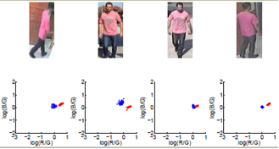
Log-Chromaticity Colorspace
Red coordinates are from the upper ROI
Blue coordinates are from the lower ROI
Assumption: same person will have approximately the same structure of the colorspace across different images.

Slide 6
Parts Shape Context (Parts SC) Representation
Extracted from a few sample coordinates of colorspace. From the lower and the upper ROIs of the image.
Coordinates from the lower ROI are called Reference (centers) coordinates
Coordinates from the upper ROI are called Data coordinates

Slide 7
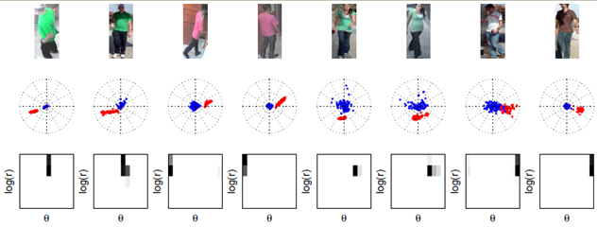
Parts Shape Context (Parts SC) Representation
Shape context is a logpolar histogram .
It is built around a single center reference coordinate and a list of data coordinates.
Formal:

Slide 8
Parts Shape Context (Parts SC) Representation
Parts SC is a combination of shape context histograms where each reference coordinate from the reference coordinates list is a center and the data coordinates surround it.
Formal:
It’s dimensions are NxM
N = number of reference coordinates.
M = number of bins (radius bins x theta bins)

Slide 9
Comparing Parts SCs
S1 and S2 are two Parts SC representations.
Cost matrix – a distance matrix between every member from S1 to every member from S2.
The formal definition of distance between the two signatures is d(S1 , S2 ) = The minimal cost matching all elements in S1 with all elements in S2 using the cost matrix C.
To compute the minimal distance between S1 and S2 the EMD code is used

Slide 10
Histogram Representation
Uses all colorspace coordinates
The x and y values of each coordinate of the colorspace is quantified to match the bins
Two histograms, for the upper ROI and for the lower.
For each part it is build separately
Each part is a 2D histogram of NxN bins.
N = number of bins of x coordinates and the y
coordinates

Slide 11
Histogram Representation
Each one of the upper and the lower histograms are flattened into a single row vector.
The two vectors form a 2 x M matrix, which is the histogram representation (M=NxN).

Slide 12
Comparing Histograms
Intersection between two histograms is:
The bins are normalized thus the not intersected values are sums up to 1 and form the distance between the histograms.

Slide 13
Comparing Histograms
The total distance between images using the histogram method is the sum of distances between the upper and the lower parts

Slide 14
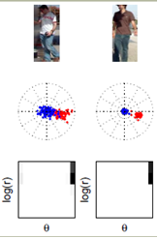
Covariance
Complementary method to parts SC and the Histogram.
Encode the absolute values of the image RGB
Unlike the both previous methods
Helps to overcome the failure
such as at the right example.
The shape contexts of both images
are similar, but the persons are
different.

Slide 15
Covariance Data
The image and its silhouette are the input
Data extraction:
Finding the mask of K most significant colors and the pixels which close to those colors.
Producing a mask of the most significant color pixels indications.
For each such pixel producing a row of the form:
The result is a Nx4 matrix (N=#color-pixels)

Slide 16
Covariance Representation
The covariance data matrix is the input, built from lower part data concatenated to the upper part data.
Computes the covariance representation by
Result in 4x4 covariance representation matrix.

Slide 17
Comparing Covariance
The distance between two covariance representations is defined as followed:

Slide 18
Thresholds
When a distance between images is calculated it is compared it a threshold value.
When d=< th means that persons on the images are similar and d> th => they are different.
In order to define a sensible threshold some statistic was made.

Slide 19
Thresholds
VIPeR database composed of 1264 images when any image has its matching image in it.
The first 632 images match the other 632 images

Slide 20
Thresholds
For every Parts SC, Histogram, and the Covariance method, computed:
Average distance
Minimum distance
Maximum distance
Table of cumulative distances
The distance that were measured were only of the correct matching images.

Slide 21
Thresholds
The most minimal distance that was spotted between two matching images was 0.12
The maximum was 0.96
The Average 0.54
0.4 >= 17.88 % (113), means: 17.88% of the distances were under 0.4, absolute number of them were 113

Slide 22
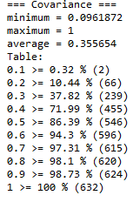
Thresholds
The other two methods statistics:

Slide 23
Thresholds - Summary
The chosen thresholds:
PartsSC-Th = 0.6
Histogram-Th = 0.5
Covariance-Th = 0.45
Average-Th = 0.51

Slide 24
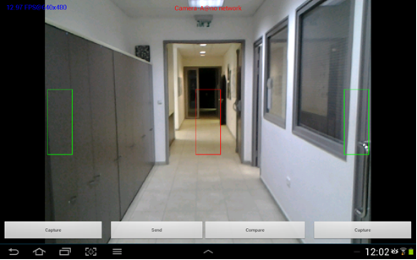
Android Application Description
The user interface is developed on android
The algorithmic part developed with c++

Slide 25
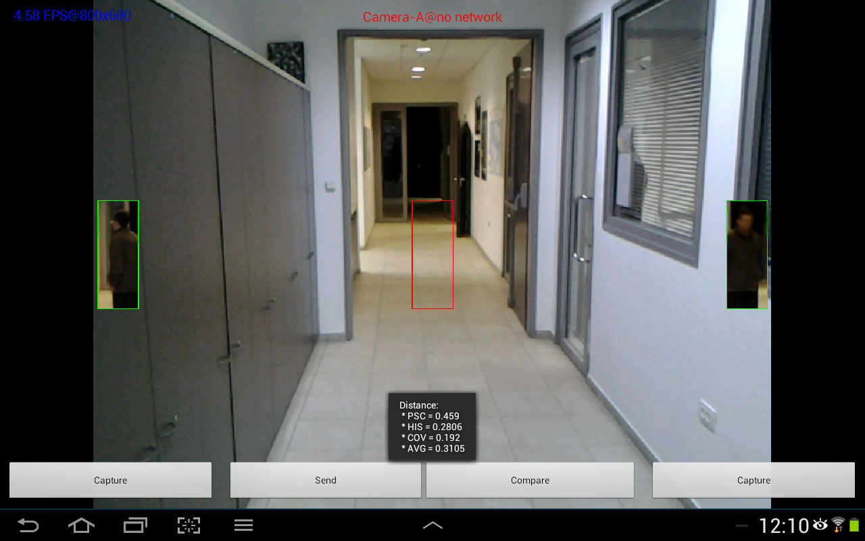
Functionalities
The main functionality is to capture two images and present the distance between it
Same person capture - values are: Parts SC = 0.45 Histogram = 0.28 Covariance = 0.192 Average = 0.3

Slide 26
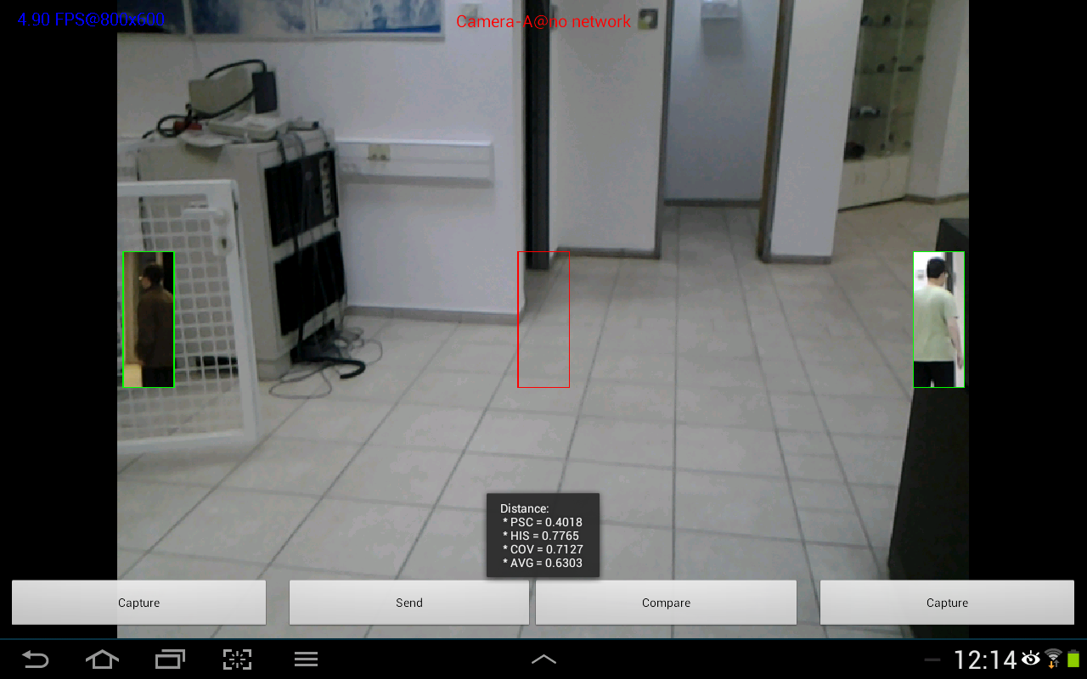
Functionalities
Example of different person:
Values: Part SC = 0.4 Histogram = 0.77 Covariance = 0.71 Average = 0.63

Slide 27
Functionalities
The user can also send the image to a distant device and change the resolution of the camera preview.
For sending the data a communication convention was set using the xml standard

Slide 28
Communication
Data transfer costs:
Image => 128 x 48 x 3 = 18432 [numbers]
Silhouette => 128 x 48 = 6144
All colorspace => 2 x (128x48) = 12288
Samples of colorspace 2 x (85 x 2) = 340
Parts SC => 85 x 120 = 10200
Histogram => 2 x 100 = 200
Covariance Data => unknown x 4
Covariance Representation => 4 x 4 = 16

Slide 29
Communication
minimum data is sent In order to allow all computations.
Parts SC – the colorspace is sent and the representation is computed at the distant device. The cost is 340.
Histogram – The representation which has 200 numbers is sent.
Covariance – The representation which has 16 numbers is sent.
Total data transfer => 340 + 200 + 16 = 556 [numbers]

Slide 30
Communication
As the calculation shows, sending the representations (and the partsSC colorspace) is much cheaper (556 numbers) than sending the original image and its silhouette
(total sent of 24576 numbers).
It is actually 24576 / 556 =~ 44 times less information to send.

Slide 31
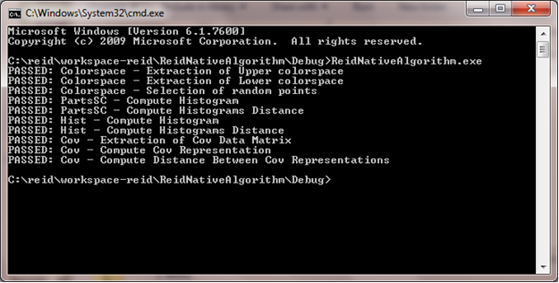
API Testing
The current project is based on a previous project done with Matlab.
For every API function it is tested that for the same input the functions produces the same output as in Matlab.

Slide 32
Conclusions
Covariance representation helps to complete the parts SC and the Histogram representations.
Using the average distance value results in a more precise conclusions.
Sending the representations is much cheaper rather than sending the original image.

Slide 33
Thank You

