Slide 1
Autonomous Navigation
Based on
2-Point Correspondence
using ROS
Submitted By: Li-tal Kupperman, Ran Breuer
Advisor: Majd Srour, Prof. Ehud Rivlin
Intelligence Systems Laboratory, CS, Technion.

Slide 2
The Problem
Robot navigation to a given target using only visual tools, in an unknown indoor planar environment.
The target is given as an image, taken from the target pose.

Slide 3
The Method
At each step, a picture is captured from the current position of the robot.
The new picture is being compared to the target picture.
The Algorithm computes the rotation and translation to the target pose

Slide 4
What Makes it So Unique
We use a special structure of the Essential Matrix for a planar scene.
Using only 2-point correspondence
Precision and numerical stability

Slide 5
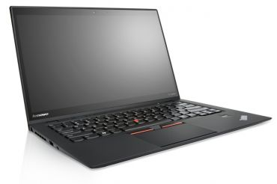
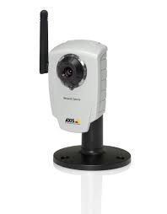
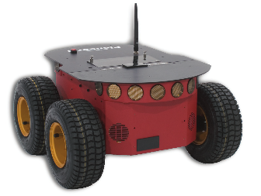
Our Components

Slide 6
Background
Epipolar Geometry
Epipolar Point
Epipolar Line
Homography
Essential Matrix

Slide 7
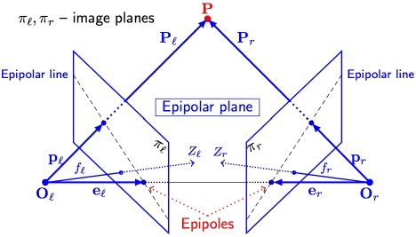
Epipolar Geometry

Slide 8
Center Of Projection

Slide 9
Epipolar Point

Slide 10
Epipolar Lines

Slide 11
Homography
3x3 matrix.
Describes the relation between a plane and an image of the plane.
One image – Warping and rotating the image, to be correlated with the plane.
Two images – Describes how 2 images are related to one another, by mapping epipolar lines.

Slide 12
Essential Matrix
3x3 matrix.
Relates corresponding points in two images.
Calibrated version of the Fundamental matrix.
, where P ’,P are two points in the images.
Useful for determining the translation and rotation between two images.
The rotation matrix can be fully recovered.
Translation up to a scale

Slide 13
Essential Matrix in Planar Model
Movement is limited to plane
Rotation around Y axis only
Rotation matrix & Translation vector -

Slide 14
Essential Matrix in Planar Model
Where $x=ρsinφ$ and $z=ρcosφ.$
We reduce the essential matrix to this structure

Slide 15
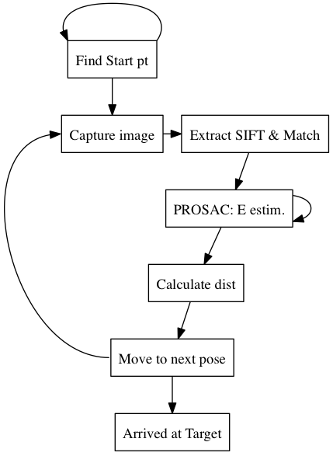
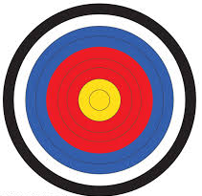
Algorithm & Implementation

Slide 16
Program Workflow
Input : Target image.
Capture an image from the current pose.
Extract and match features from both images.
Filter the largest inliers set using PROSAC.
Using the best model estimated, extract matrices R and T.
Calculate the distance to target.
Move to a new pose and repeat step 1 until target pose is reached.

Slide 17
Starting position & correspondence
Finding a good starting point –
Scanning and covering 360° of the room.
Finding correspondence –
Using SIFT method and Brute force matching
Eliminate bad matches

Slide 18
Estimating E
Estimating the Essential Matrix
Only 2 point correspondence to estimate E.
Using a variation of PROSAC.
Finding the largest inlier set that agree with E.

Slide 19
Estimating E (Cont.)
Estimating the Essential Matrix (cont.)
Linear equation matrix Ax = 0:
Where
Constrained version

Slide 20
Estimating E (Cont.)
Estimating the Essential Matrix (cont.)
Unit circle and ellipse intersection
Using SVD.
Possible results:
2 (or 4) intersection points - use for our E.
No intersection points – no solution.
Infinite number of points – Pure Rotation.

Slide 21
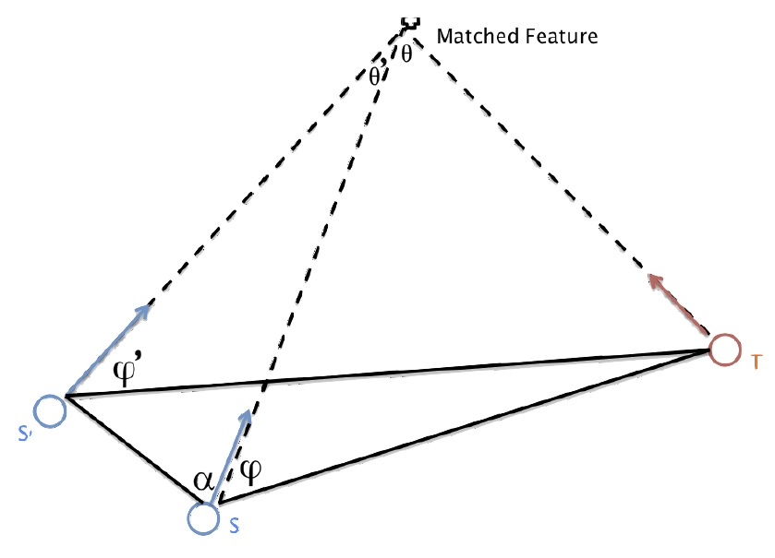
What’s the next step?
Pure Rotation –
Robot at target, but wrong orientation.
Calculating Distance
With the help of a third image.
2 Methods implemented:
Triangle
Cross ratio

Slide 22
Design and Implementation
Using ROS nodes to communicate between modules, the robot and the camera.
Auto Navigator – main module.
Robot Controller
Image Capturer + Undistorted
Epipolar Solver

Slide 23
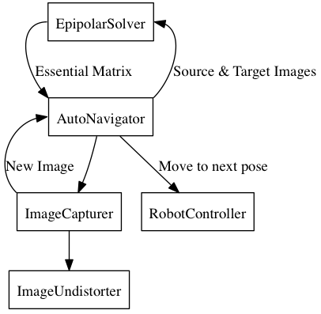
Auto Navigator Interface Diagram

Slide 24
Using ROS
Based on Nodes – services.
subscribe or publish from\to a Topic.
ROSARIA – controlling the robot.
Axis Camera – photo stream, capturing images.

Slide 25
Challenges
Eliminating bad images
Algorithm divergence near target (Triangle method)
Computing distance to target
Restarting after bad step
Algorithm troubles with a dominant plane

Slide 26
Experimental Test Results
Convergence : 3-8 iterations, 1-20cm from target.
Triangle method algorithm diverges when close to target.
Comparing distance calculation method

Slide 28
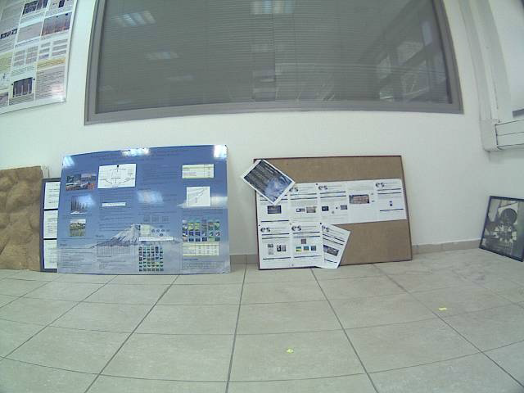
Target Image

Slide 29
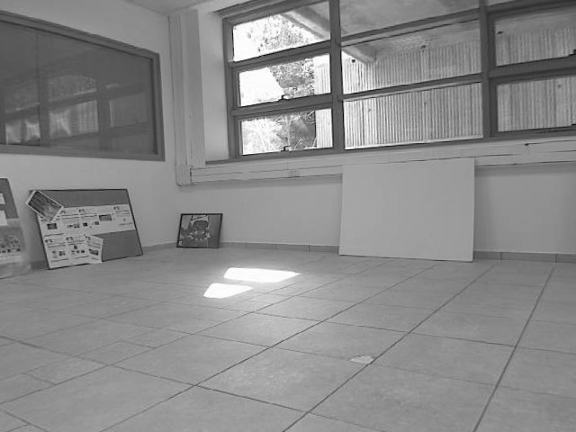
Starting Position

Slide 30
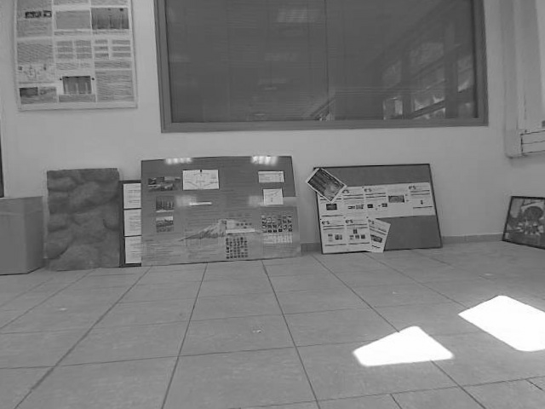
Midway – 2nd iteration

Slide 31
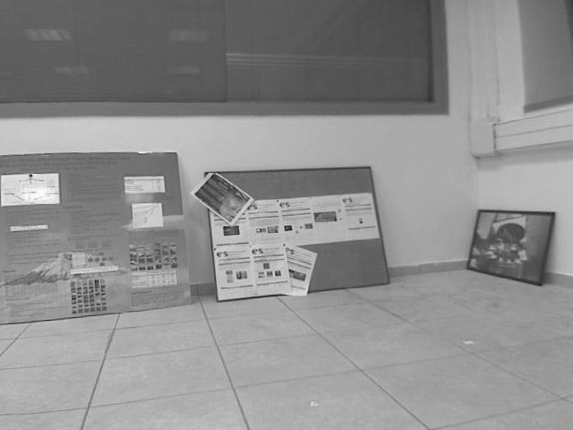
The End

Slide 32
Target VS. The End
Target
End

Slide 33
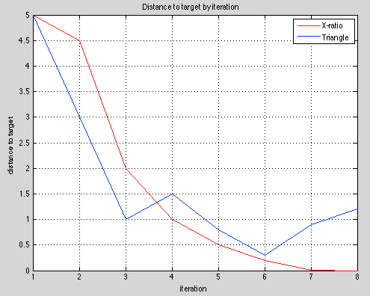
Measurables
Distance to target by iterations

Slide 34
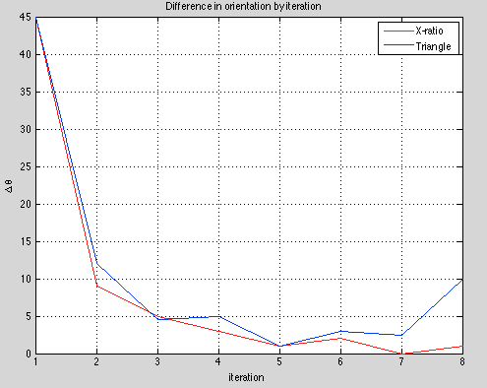
Measurables
$∆θ −$Difference in orientation

Slide 35
Summary
Vision based navigation can deduce orientation and distance using:
Feature matching
Essential Matrix
Planar movement
Unique Essential Matrix structure.
2-point correspondence.
The algorithm quickly converges close to the target – pose + orientation.

Slide 36
Future Work
Solving divergence at target pose.
Better elimination of “bad” image sources (wrong poses).
Qualifier for better matches and features for a more efficient estimation each step.
Solve issue with dominant plane scene

