Slide 1
LANDING Extracting Angles From an Image
Submitted by: Li-tal Kupperman, Ziv Nachum
Advisors: Yair Atzmon, Aram Movsisian
Center for Intelligent System, CS, Technion
July 2015

Slide 2
The Main Goal
The Master project:
Land a quadcopter on a moving target
Our part:
Extract angles from an image
Using data from image stream

Slide 3
Recognizing the target
Hough Transform
First (unsuccessful) trial
Unable to detect ellipses… only rounded circles.

Slide 4
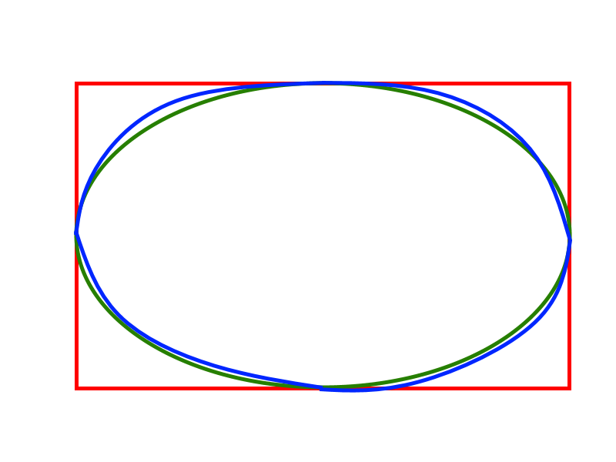
Recognizing the target
Detection Heuristics
Comparing areas of ellipses and corresponding rectangles.
Acquire a set of different ellipses. (no repetitions)
Choosing only the relevant ellipses, according to our target.

Slide 5
Choosing the target
First Target
Problem: Difficult to distinct the actual target from other objects.
Apparently not as unique as we thought…

Slide 6
Choosing the target
Second Target
Looking for 6 circles, in a certain formation.
Easier to detect…
Problem: The target is too symmetrical.
Unable to decide on the direction the camera was facing.
Unstable results.

Slide 7
Choosing the target
Final Target
Looking for 7 circles, in a certain formation.
Easier to detect…
The extra circle allows to decide on a specific order.
Led to stabilized results.
Matches the direction of the camera in the real world.

Slide 8
Extracting The Angles
Using two sets of points:
Points in the 2D image plane
Ellipses in the frame
Points in the real 3D world
The real target

Slide 9
Extracting The Angles
Using Perspective-n-Points:
Estimate camera pose from given n 3D points and their projection in an image.
solvePnP function.
Output:
Rotation vector
Translation vector
Represents the position on the camera with regards to the real world

Slide 10
Extracting The Angles
Converting the rotation vector, into a rotation matrix
Rodrigues function
Easier to calculate the angles from a matrix.
Extracting the angles using a given calculation
As shown in the next slide

Slide 11
Extracting The Angles
$$M=\left(\begin{matrix}m_{00} & m_{01} & m_{02} \\ m_{10} & m_{11} & m_{12} \\ m_{20} & m_{21} & m_{22}\end{matrix}\right)$$
$$θ_{1}=atan2\left(m_{12},m_{22}\right)$$
$$c_{2}=\sqrt{m_{00}^{2}+m_{01}^{2}}$$
$$θ_{2}=atan2(−m_{02},c_{2})$$
$$s_{1}=\sin\left(θ_{1}\right) c_{1}=cos⁡(θ_{1})$$
$$θ_{3}=atan2(s_{1}m_{20}−c_{1}m_{10} , c_{1}m_{11}−s_{1}m_{21})$$

Slide 12
Final Results
3 angles, representing 3 axes.
Final results displayed in degrees.
Using there 3 angles it is possible to determine the quadcopter’s next move towards the target

Slide 13
Examples
X: 17.4068, Y:6.23963, Z:-80.3897

Slide 14
Examples
X: 25.249, Y:-8.4599, Z:57.6348

Slide 15
Examples
X: 72.1469, Y:-2.32951, Z:-115.046

