Slide 1
Monocular Vision Assisted Odometry
Submitted by: Giorgio Tabarani, Christian Galinski
Supervised by: Amir Geva
CIS and ISL Laboratory, Technion

Slide 2
Contents
Introduction
Tools
Algorithm
GoodFeaturesToTrack
CalcOpticalFlowPyrLK
Evaluate track point
Distance calculation
Odometry correction
Theoretical results
Going live
Conclusion

Slide 3
Introduction

Slide 4
Introduction
Laser sensors are great devices for obstacle detection in robots but come with a high price tag
Cameras, on the other hand, are relatively cheap and easily accessible to everyone (eg. smartphones or digital cameras )
In this project, we used a smartphone’s camera on a robot in order to determine the distance between the robot and its closest obstacle and steer it away in order to avoid collision

Slide 5
Tools

Slide 6
Tools
Developed in C++ using Visual Studio
OpenCV 2.4.9 library for image analysis
Glued together with the robot through an Android application with the use of JNI and picture from the device’s rear camera
Developed using Nexus 5 device with pictures scaled down to 640x480 pixels.

Slide 7
Algorithm
Overview

Slide 8
Overview
goodFeaturesToTrack on both frames
cornerSubPix on both vectors from previous step
calcOpticalFlowPyrLK
Evaluate the trackpoint
Calculate distances and correct odometry

Slide 9
Algorithm
GoodFeaturesToTrack

Slide 10
GoodFeaturesToTrack
OpenCV algorithm used in order to find the best points we should keep track of which will help calculate the distance each object has moved
Notes:
Mention of CornerSubPix – made sub-pixel precision

Slide 11
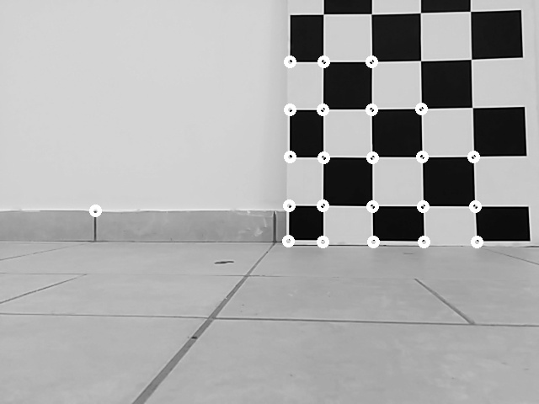
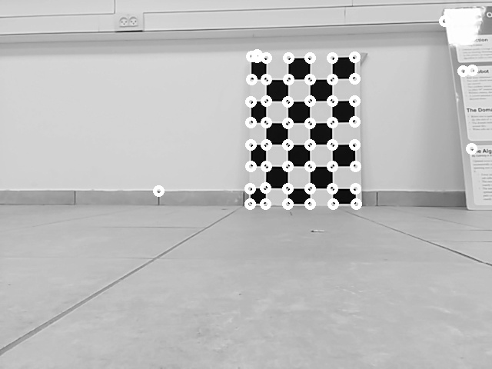
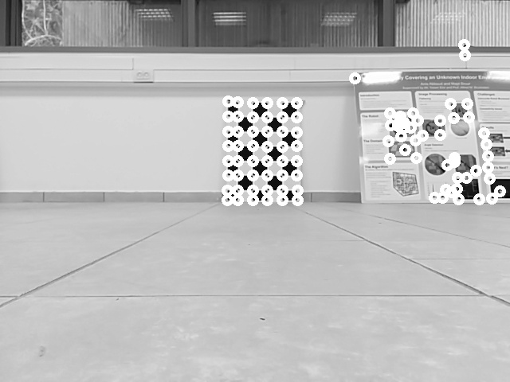
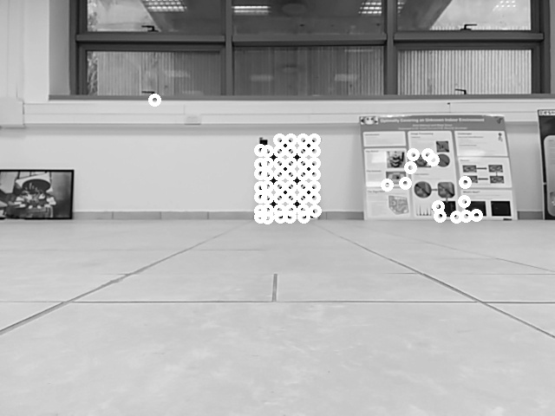
GoodFeaturesToTrack

Slide 12
Algorithm
CalcOpticalFlowPyrLK

Slide 13
CalcOpticalFlowPyrLK
Algorithm used in order to see each corner from one frame to where it was mapped in the second frame

Slide 14
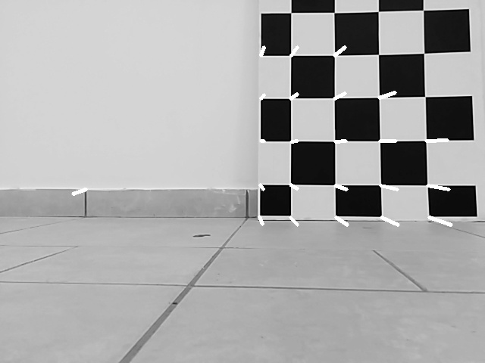
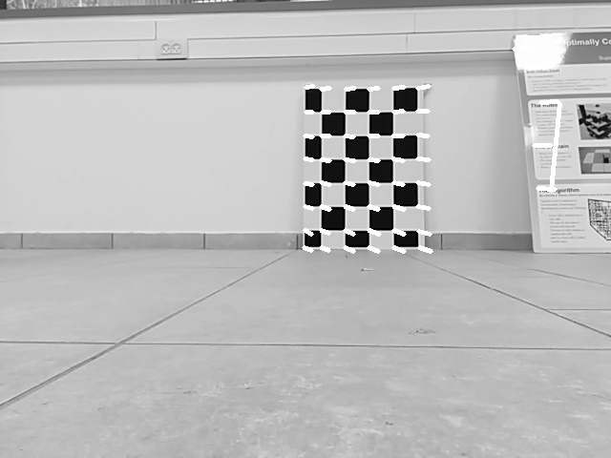
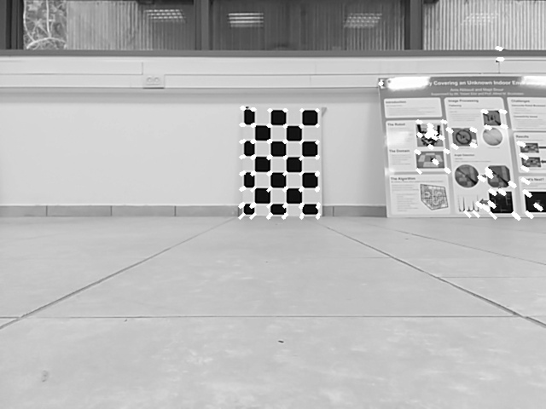
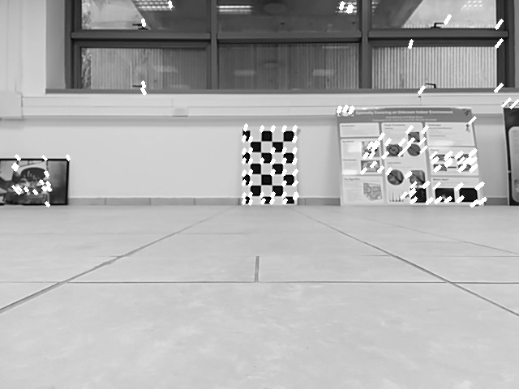
CalcOpticalFlowPyrLK

Slide 15
Algorithm
Evaluate track point

Slide 16
Evaluate track point
Track point is mainly the point which the robot is moving towards
We took each two matching points from the two frames and calculated the line’s equation which passes through them
Intersection point of all these lines is the track point
This is the only point which does not change its position between two consecutive frames and thus we used it in calculating the distance

Slide 17
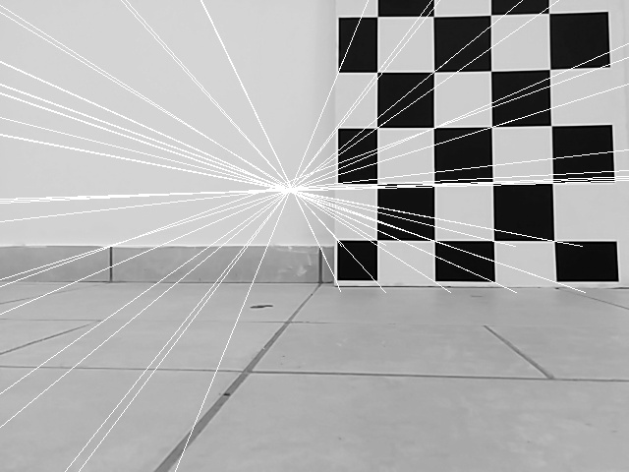
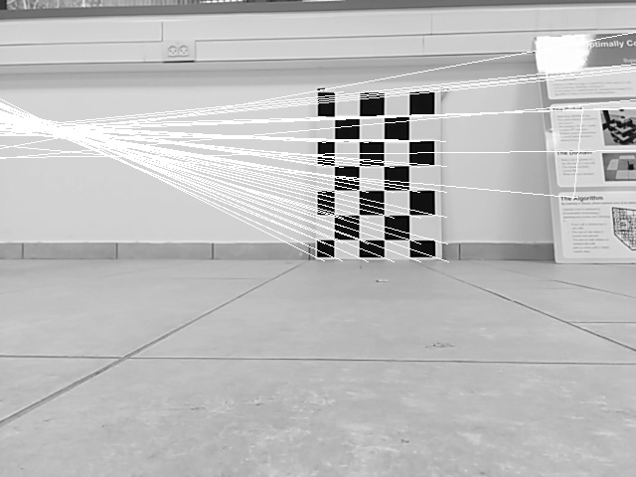
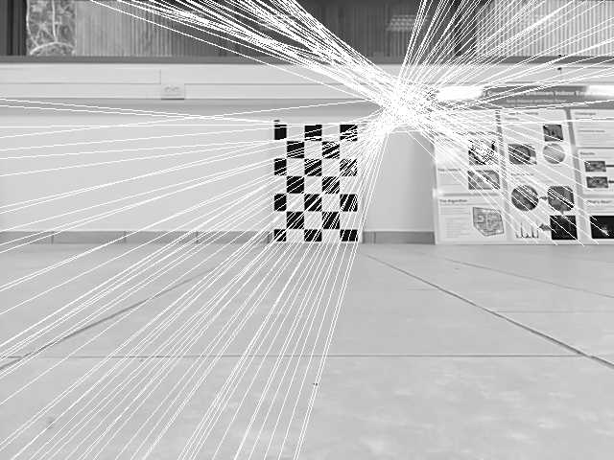
Evaluate track point
Notes:
Mention of second run to improve location of track point

Slide 18
Algorithm
Distance calculation

Slide 19
Distance calculation
Using the “Pinhole projection formula” and the fact , we get the following formula
- object’s distance from the point where the first frame was taken in cm
- object’s distance from the point where the second frame was taken in cm
- object’s size in pixels in the first frame
- object’s size in pixels in the second frame
- step size in cm
Notes:
The fact the above equation has division made things trickier trying to avoid numerical errors when the difference between x1 and x2 is small

Slide 20
Distance calculation
Using the aforementioned track point:
Distance in pixels between the track point and a corner in the first frame defines x1
Distance in pixels between the track point and the corner in the second frame defines x2
Since we’re using the track point which doesn’t change between the two frames, we are basically measuring the same object’s size
Notes:
In this way, since the track point stays fixed, its distance to the nodal point is not determined, so we can choose it and set it as equal to each corner’s distance to the nodal point, and so we are able to get the pure distance to these corners without being dependent on any other specific corners

Slide 21
Algorithm
Odometry correction

Slide 22
Odometry correction
As it stands, the results from above calculations were not sufficient
Attempts to improve the calculations included updating the odometry step size per move and thus achieve a more accurate estimate for the distance from an obstacle

Slide 23
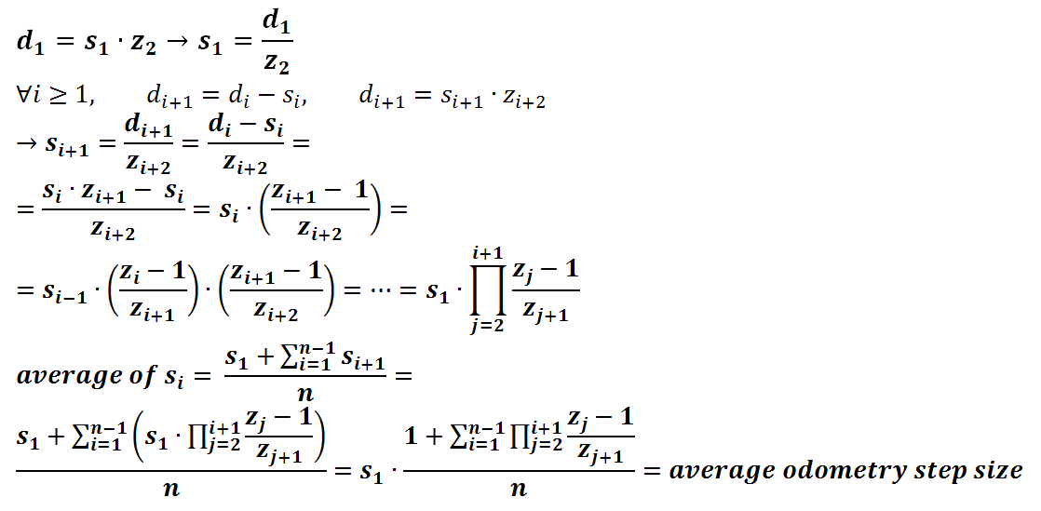
Odometry correction
Using the above mentioned equation of and if we denote , where were calculated from the frame’s analysis as explained before, we can write

Slide 24
Odometry correction
Thus, by knowing the average odometry step size we can get the value of and afterwards calculate the value of every and depending on a realistic step size for the move itself and not an average one which depends on all the other moves as well

Slide 25
Theoretical Results

Slide 26
Theoretical Results
We ran several simulations on the provided “Calibration” data set
The goodness of the algorithm was measured by the quality of the graph and the trend line

Slide 27
Theoretical results
First try:
Assuming each step’s size was the given encoder step approximation
We see a lot of inconsistencies in the slope

Slide 28
Theoretical results
Second try:
Using the improved algorithm described in the odometry correction section using n transitions between frames
Outstanding improvement and consistency in the results

Slide 29
Theoretical results
Extra try:
Simulation on reduced input which is closer to the obstacle
Even better results

Slide 30
Theoretical results
Moving towards more practical solution:
Using the given step size for a fixed amount of steps and then using the average step size for the remaining moves
Notes:
We notice in all graphs that the closer we are to the obstacle, the closer we get to the Truth line

Slide 31
Going live

Slide 32
Going live
While integrating the image analysis and processing code we started facing real world problems such as drift and hardware issues

Slide 33
Going live
The robot’s rotations were not always in the same angle despite having the same parameters
Solution: rotating in a constant speed over a fixed amount of time
The solution to the above problem caused another problem by itself: the encoders’ readings got messed up due to misuse by the above solution and the robot’s forward movement got defected.
Solution: none found since we don’t have a direct access to each encoder separately in order to modify it

Slide 34
Going live
Dealing with possible unwanted rotations caused by image analysis hiccups:
if(dist < 75)
Enter safe mode
if(dist <= 25)
Rotate
if(in safe mode)
if(dist >= 55)
Move forward
if(dist >= 75)
Exit safe mode
if(dist < 55)
Rotate

Slide 35
Going live
https://www.youtube.com/watch?v=HE8XifzU44s

Slide 36
Conclusion

Slide 37
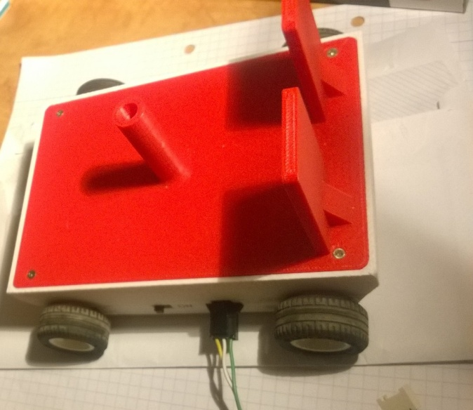
Conclusion
Camera’s prices are falling rapidly and they contain rich data just as any other sensor, even in monocular vision systems
Our system is capable of estimating a robot’s distance from its closest obstacle while taking into account many variables such as low resolution images, robot’s drift and encoders’ issues

