Slide 1
Smart shot
Boyko Konstantin
Rechister Lev

Slide 2
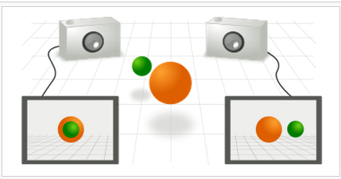
Correspondence problem

Slide 3
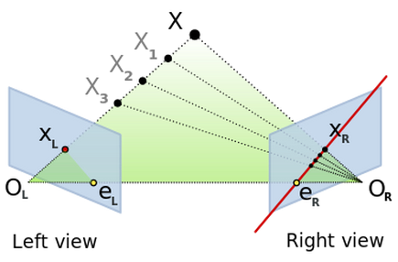
Fundamental matrix

Slide 4
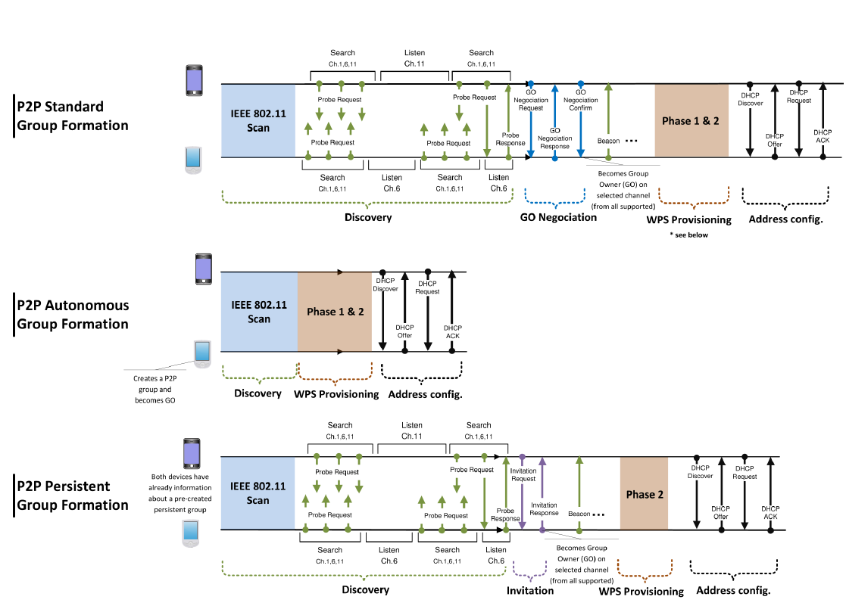
WiFi Direct (low level)

Slide 5
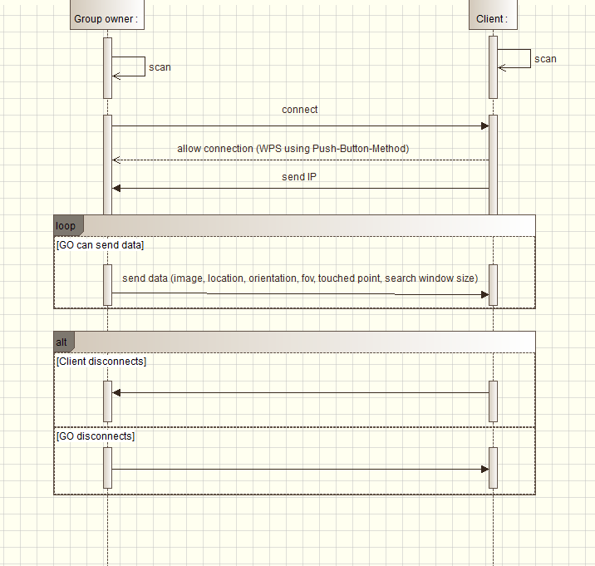
WiFi Direct (GO to client)

Slide 6
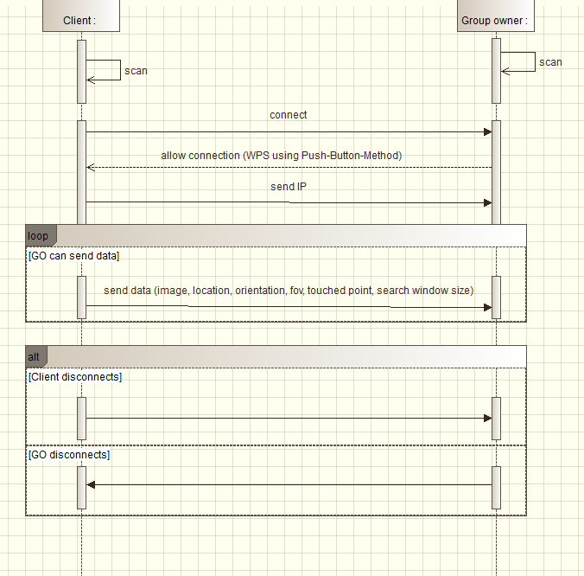
WiFi Direct (client to GO)

Slide 7
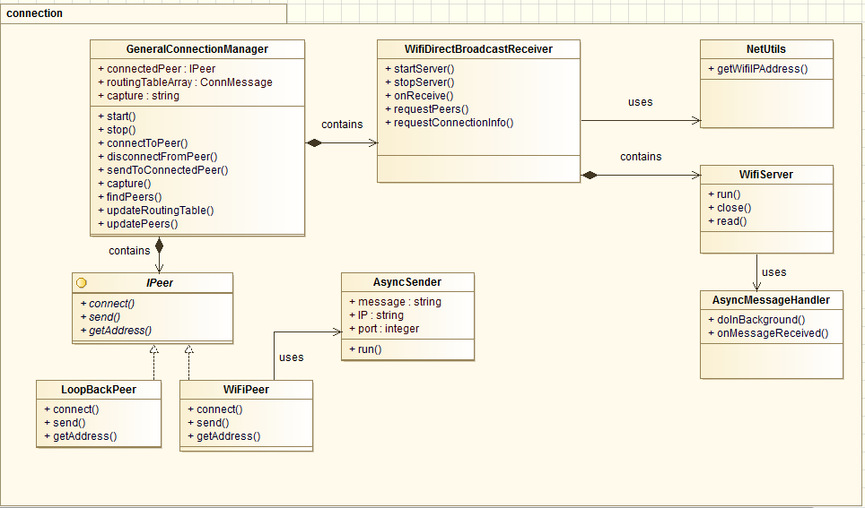
Connection package design

Slide 8
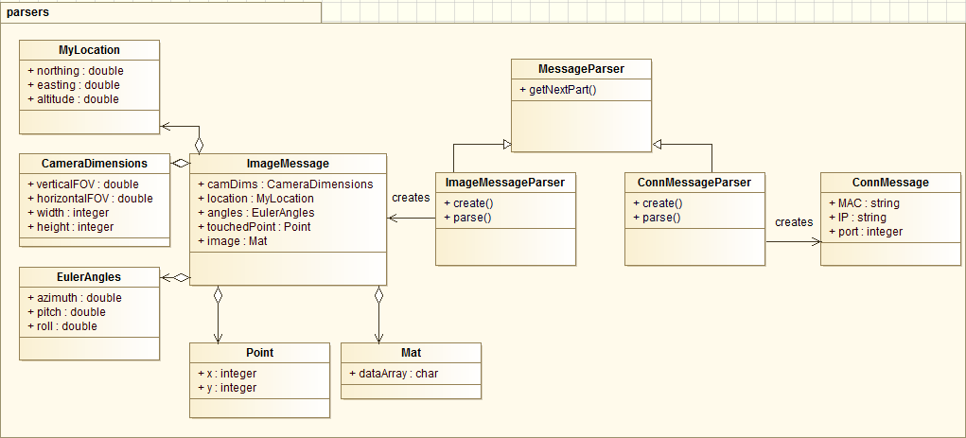
Types of messages

Slide 9
Location data
Android gives us information about latitude, longitude and altitude
SOREPP expects UTM-like format

Slide 10
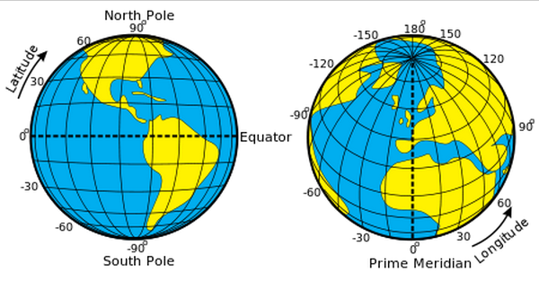
Latitude, Longitude

Slide 11
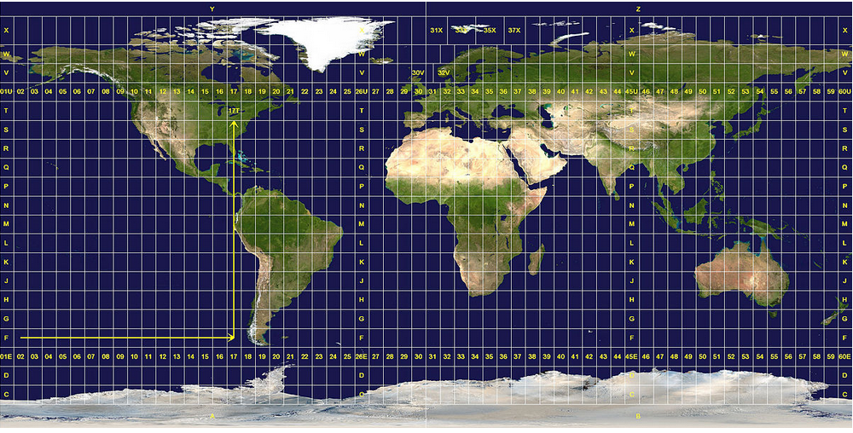
UTM grid

Slide 12
Orientation data
Android API supplies us with information about azimuth, pitch and roll
Azimut, pitch and roll are adjusted to be like in GeoCam application (this app was primarily used for SOREPP testing)
Gimbal lock problem (the device should be hold in front of the face)

Slide 13
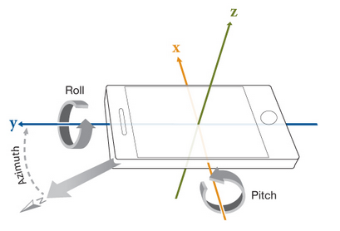
Orientation data

Slide 14
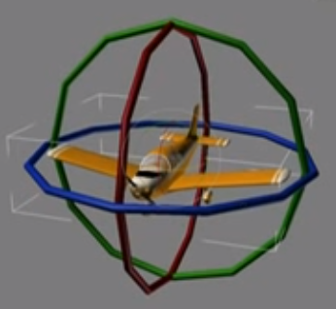
Gimbal lock

Slide 15
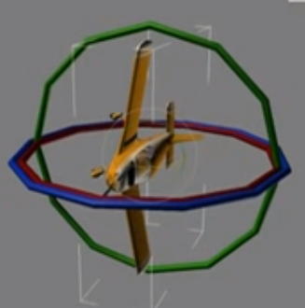
Gimbal lock

Slide 16
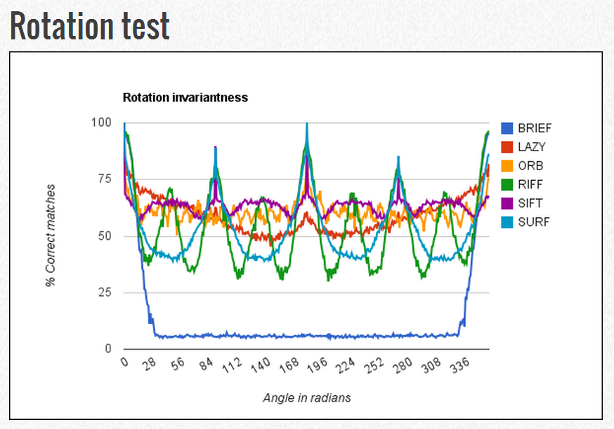
Why SIFT?

Slide 17
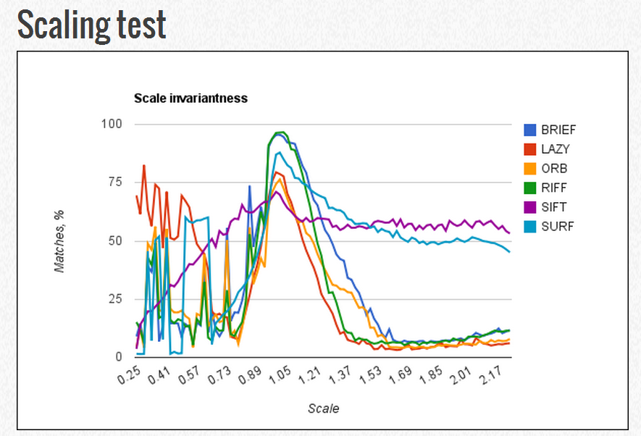
Why SIFT?

Slide 18
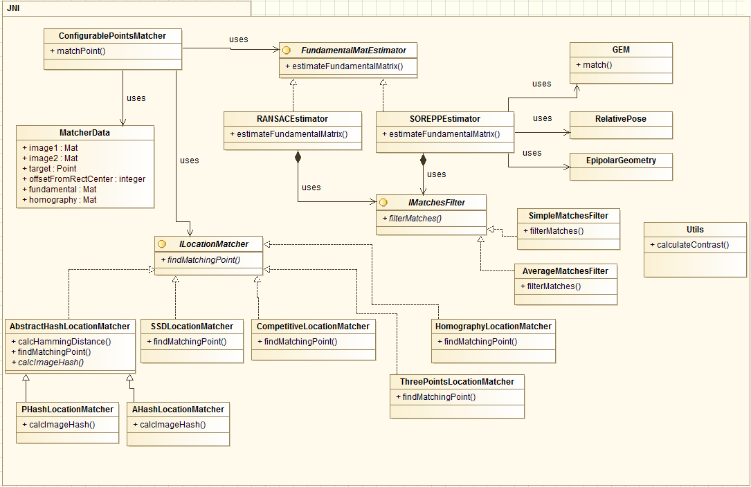
Algorithms

Slide 19
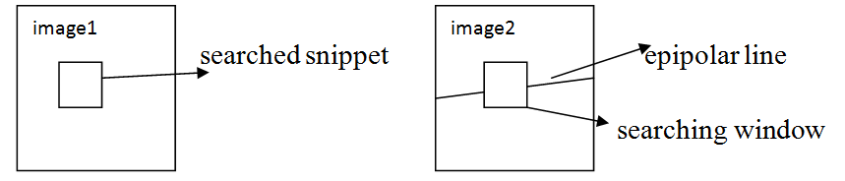
Search across epipolar line

Slide 20
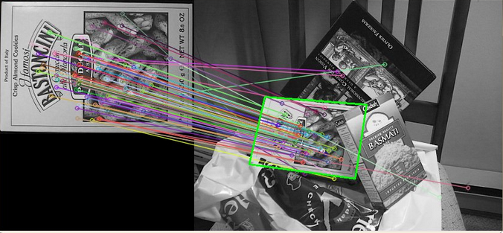
Homography

Slide 21
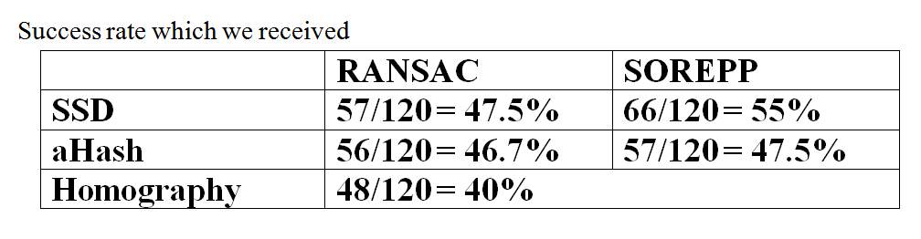
Testing results 1

Slide 22
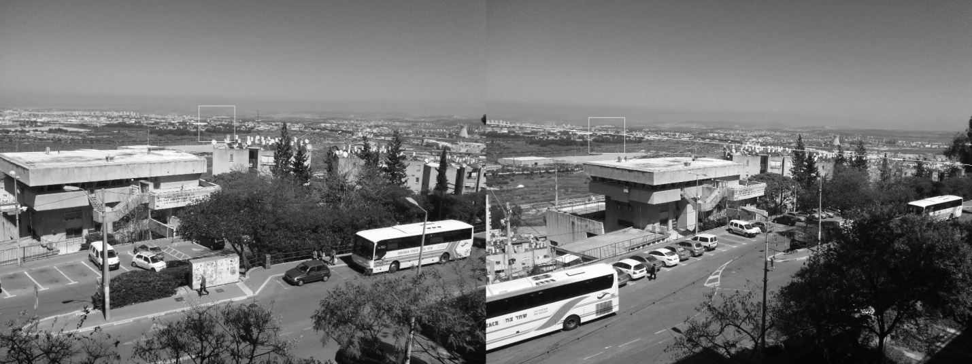
Ransac+aHash(far-away target)

Slide 23
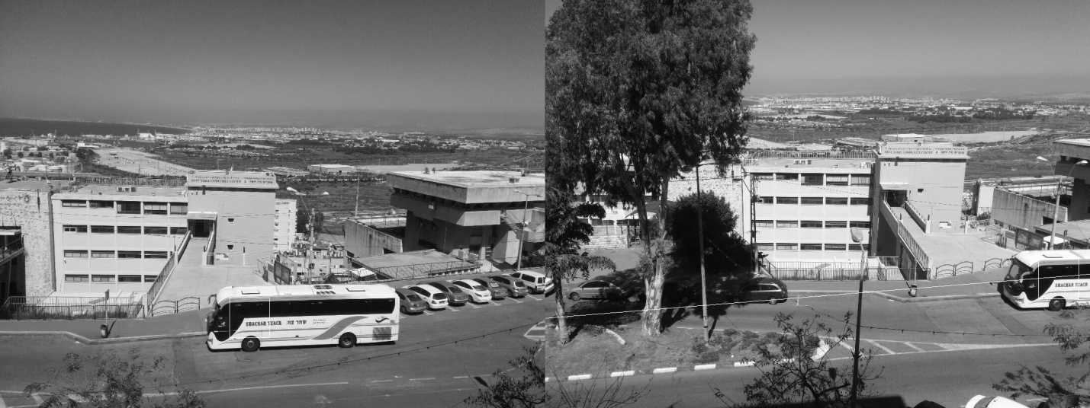
Ransac+aHash (bus)

Slide 24
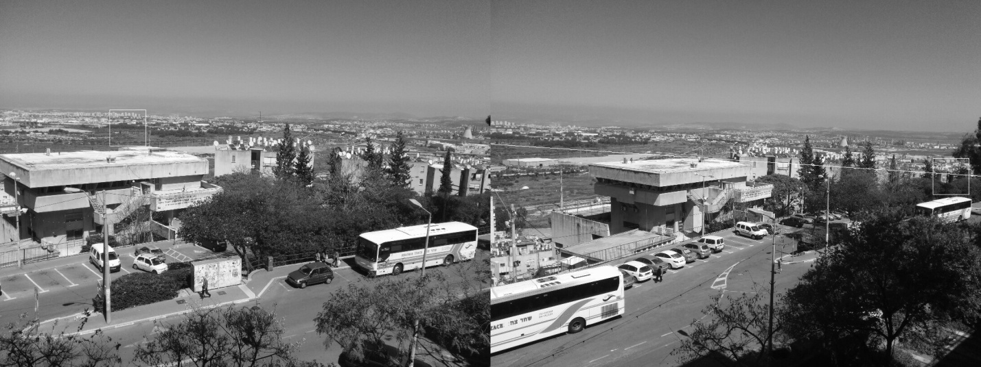
Ransac+aHash didn’t work

Slide 25
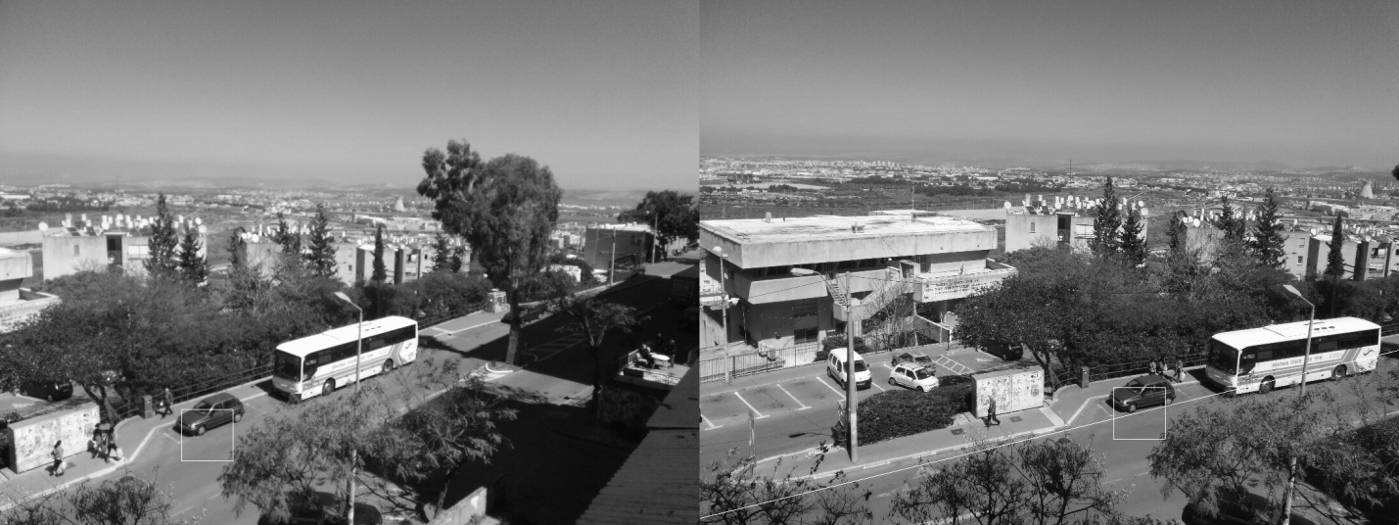
Ransac+SSD worked

Slide 26

RANSAC+SSD (far-away target)

Slide 27
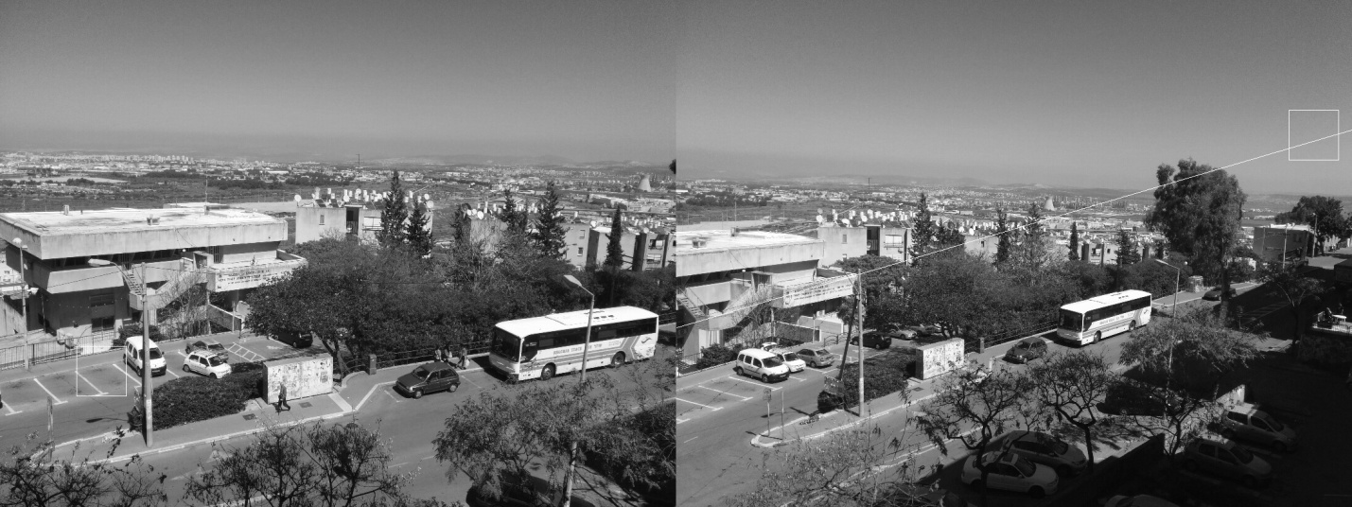
Ransac+SSD didn’t work

Slide 28
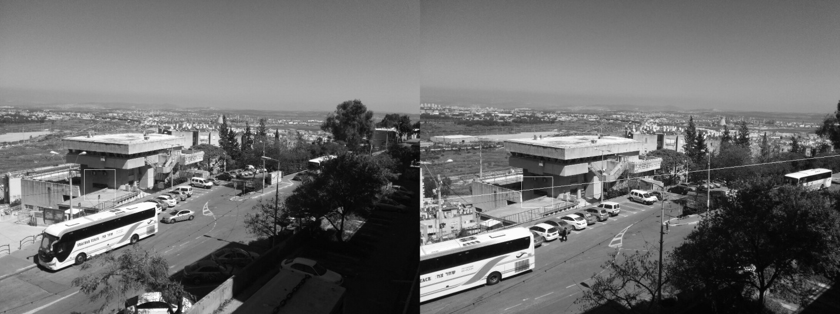
SOREPP+aHash (found window)

Slide 29

SOREPP+aHash didn’t work

Slide 30

SOREPP+SSD (roof)

Slide 31

SOREPP+SSD didn’t work

Slide 32

Homography (under occlusion)

Slide 33
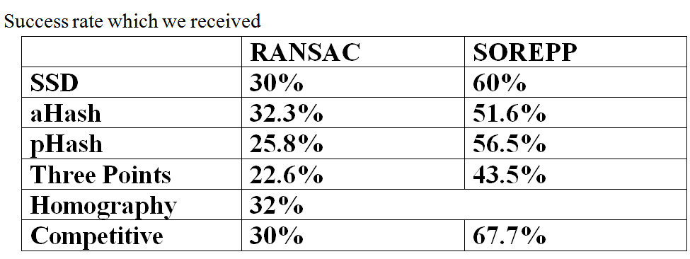
Testing results 2

Slide 34
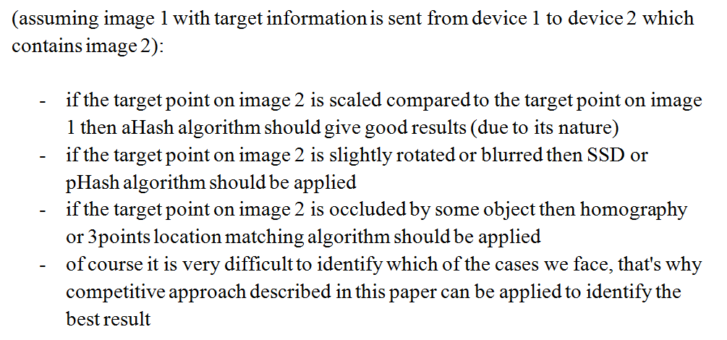
Conclustion

Slide 35
Presentation
demo

