Slide 1
Face Detection, Recognition
and Pose Estimation
By Vardan Papyan &
Emil Elizarov

Slide 2

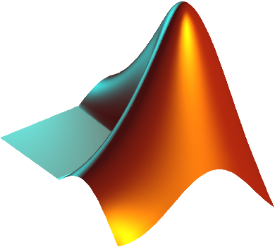


Our project was divided into several parts
The first part was making an Android Application on Qualcomm’s
phone using OpenCV library
The second part was analyzing the application’s accuracy
The third part was research in Matlab which included pose
estimation and improved face recognition.

Slide 3
App’s Control Flow in a Nutshell
Detect faces in the current frame
If all parts of face
are not found
Detect eyes, nose and mouth in the face detected
If person is not in
tracked people list
If all parts of face are found
When tracked
face is lost
Align the face to template according to parts detected
Recognize aligned face from saved database
If person is in tracked people list
Track the face

Slide 4
Face Detection
Detect a face in the current frame.
Detect eyes, nose and mouth in the corresponding region of interest aka ROI.
Use OpenCV’s detectMultiScale for the detection together with OpenCV’s included cascades.

Slide 5
Face Aligment
Align the face to predetermined template of an average face
Use OpenCV’s warpAffine
function for the aligment.

Slide 6
Face Recognition
Convert the face into an LBP vector
Using nearest neighbor find the closest matching person
If the distance to the closest person is below a given threshold, consider the faces equal
The distance between the face and the closest face in the database is shown

Slide 7
Face Tracking
Using OpenCV’s CamShift we track the recognized person
The tracking is based on the color histogram of the human skin

Slide 8
App Features
The user can:
add people to its database on the fly
choose the people the app recognizes
choose the recognition threshold
choose the number of pictures per person the app uses for training
choose the people the app tracks
Also, the app has a parallel option to do the heavy calculations on a special worker thread.

Slide 9
Analyzing The
Recognition
Accuracy
We’ve measured the Chi-Square distance between pictures of the same person and between pictures of different people.
Using these distances we’ve made two histograms.

Slide 10
ROC
By choosing a threshold for determining whether two pictures are of the same person we receive a true positive rate and a false positive rate. We then choose different thresholds and receive the ROC curve.

Slide 11

MATLAB Research
We’ve tried to achieve the following with our MATLAB research:
Face pose estimation using LDA.
The three categories were frontal, left profile and right profile.
Improvement in face recognition accuracy using PCA and LDA.

Slide 12
Face Pose Estimation
We’ve used LDA in order to reduce the dimensionality of our LBP representation for us to be able to classify the correct pose.
This graph shows the L2 norm distance between the dimensionally reduced vectors.

Slide 13
Face Recognition Improvement
LDA Only
Using LDA only in order to recognize faces yielded bad results.
We could not separate same from not same properly.

Slide 14
Face Recognition
Improvement
Huge improvement from LDA only is achieved but further improvement can be done
Using PCA only

Slide 15
Face Recognition
Improvement
Using PCA and then LDA
Best results achieved in the project

Slide 16
Comparison
Between
ROC Curves
We can clearly see the improvement
from this graph

