Slide 1
Multiframe Point Correspondence
By Naseem Mahajna & Muhammad Zoabi

Slide 2
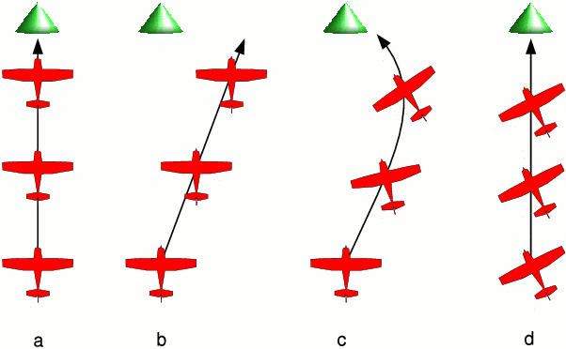
What is it about?
Implementing a noniterative greedy algorithm for Multiframe point correspondence. According to: “IEE Transactions on pattern analysis and machine intelligence” papers.
Research on gain functions and their affect on results accuracy.

Slide 3
The problem:
In motion correspondence, given an image sequence, the problem is to find the correspondences between the feature points in the images that occur due to the same object in the real world at different time instants.
Given a sequence of images, each represents a real time position of moving objects that there is no other distinguishing feature among these objects.

Slide 4
The problem – cont:
The goal is to identify the tracks of each real time object according to the given images only.
Assumption: The input can contain both real world object points and points due to sensor noise.
Each track in the output consists of :
Only real-world object points .
Only sensor noise points.
The achieved results can be used for many applications, specifically objects tracking.

Slide 5
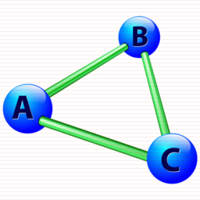
The algorithm:
The algorithm we’ve used is a noniterative greedy algorithm.
Input: a sequence of n frames , (each of dimensions: ) correspond to n time instances
, , each frame contains points.
Output: A set of tracks, where each track corresponds to a unique object in the real world, and specifies its position in every frame from entry to exit in the scene.

Slide 6
The algorithm – cont:
The input should be represented as a Directed Graph, each frame is represented as a set of vertices .
Iteratively: in the iteration - i , for each vertex u in every frame j, , an edge is added to the graph from vertex u to every vertex v in frame: i+1.
For each edge, we calculate its weight using a specified Gain function.
Applying weighted-maximum-path-cover algorithm on the described graph should yield the ‘correct’ tracks so far ( i-th frame ).

Slide 7
The algorithm – cont:
We can categorize the edges in the graph as follows:
Extension edges: The edges added by the iterative construction of the graph from frame i to frame i+1.
Correction edges: The edges added by the iterative construction of the graph except extension edges.
False Hypothesis: We define an edge to be a False Hypothesis if it has a directed path from an edge replaced by a Correction edge.
At the end of each iteration, we mark the False Hypothesis edges and remove them from the graph.

Slide 8
The algorithm – cont:
Initialization problem: In order to predict we needed backward correspondences of previous frames. The problem is that in the first two frames there is no backward correspondences for predicting.
Solution: At the beginning, the algorithm predicts a default simple motion for the first two frames, and after K iterations, we apply a backtracking algorithm using the same technique only backwards to fix the initial predictions.
K is called ‘window size', it's given by the user. The higher K is, the better accuracy we achieve but there is a tradeoff in performance.

Slide 9
Gain functions:
Definition: A Gain function is a function that has one argument: an edge, and returns its weight.
Why do we need a gain function?
Its our way to tell the algorithm which edge is preferred among all the possible edges. This way we can determine how the algorithm builds the tracks for different types of motions.
We’ve used the proposed gain function from the papers, as it can be modified according to the type of motion.

Slide 10
Gain functions – cont:
The gain function we’ve used:
Note: all the edges here are presented as vectors.
e: observed edge, : predicted outer edge from vertex x.
The gain function contains two components, that can be given different weights in the calculation using the parameter .

Slide 11
Gain functions – cont:
The two components are:
: Represents the directional coherence, this criteria prefers smooth changes in the direction of motion.
: Represents the distance between the predicted and the observed position of the point. This criteria prefers the match which is closest to the expected position.

Slide 12
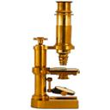
Environment & Tools
C++
Lemon Graph Library (C++).
Visual Studio workspace.
ImageJ: Image processing and analysis tool.

Slide 13
Results:
We’ve analyzed a short video of moving balls. The objects move in a semi-linear motion.
We’ve converted the video to a sequence of 22 frames (n=22) and calculated the coordinates using ImageJ tool.
Algorithm parameters:
We’ve applied our algorithm on the coordinates file.
The input and output figures are shown in the next slides.

Slide 14
Input frames video:

Slide 15
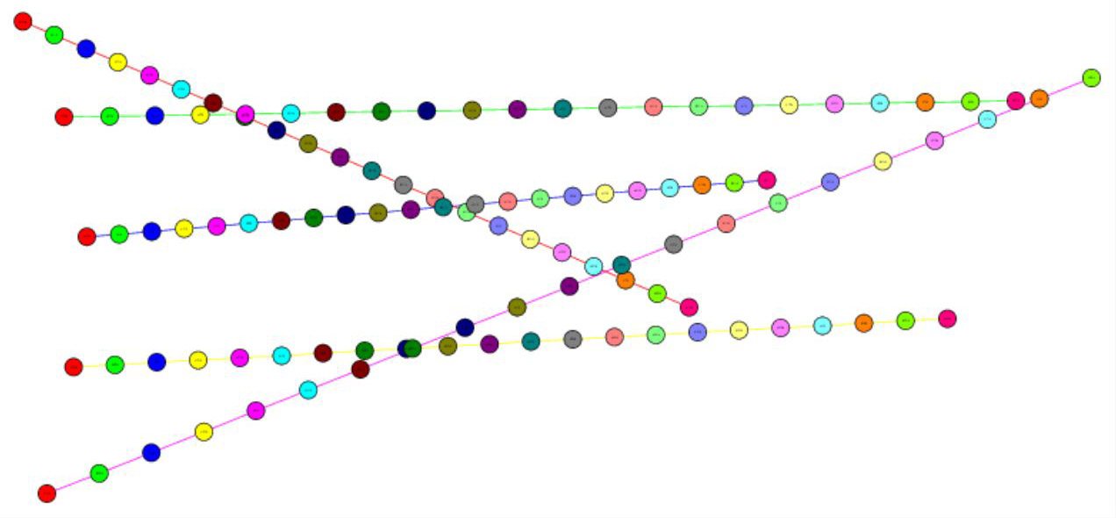
Results:

Slide 16
Conclusions:
According to the papers and our research, the parameter in the gain function should be set to 0 ~ 0.1 (close to 0), thus giving more weight to the direction of motion.This way we can achieve more accurate result, concerning the type of motion.
Another important aspect for accuracy is the predicted points, the more they are ‘close’ to the observed points, the more accurate the algorithm is. These points, are determined by the user according to the type of the objects’ motion.

Slide 17
Conclusions-cont:
The algorithm provides the option to choose between accuracy and performance by setting the backtracking window size.
We have studied, implemented and tested the theory behind the proposed algorithm. The results have shown the efficiency and accuracy of the algorithm in detecting the tracks for every real-world object.

Slide 18
references:
Paper: “IEE Transactions on pattern analysis and machine intelligence- A noniterative greedy algorithm for multiframe point correspondence”
- By Khurram Shafique & Mubarak Shah

Slide 19
Thank you

