Slide 1
Background Objects Identification Using Texture and Color
Ilya Gurvich
An Undergraduate Project under the supervision of Dr. Tammy Avraham
Conducted at the ISL Lab, CS, Technion

Slide 2
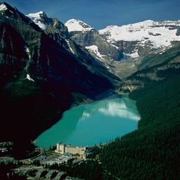

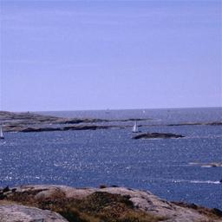
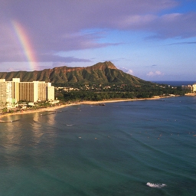
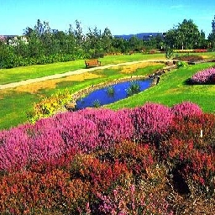
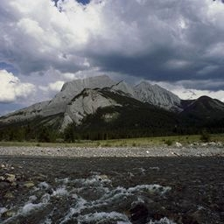
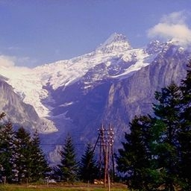
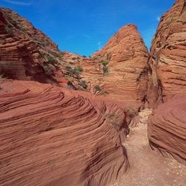
Scenery Images
Notes:
Simpler than street scenes, indoor scenes.

Slide 3
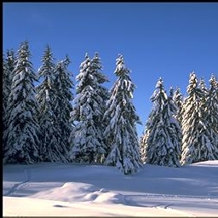
The purpose of this project
What is it?

Slide 4
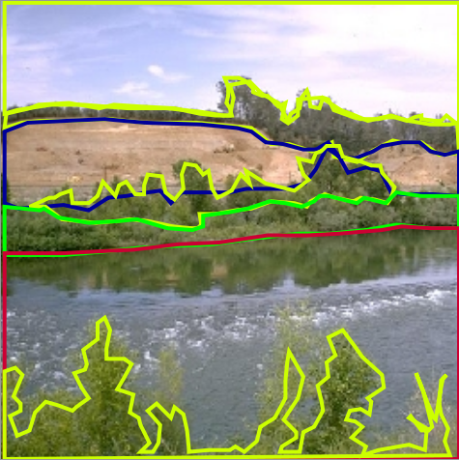
LabelMe Database
sky
trees
hill
trees
brushes
river water
trees

Slide 5
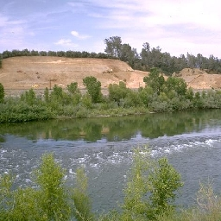
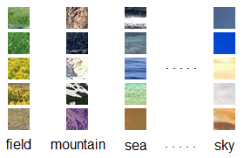
Division to patches

Slide 6
Dataset size
“Ourdoor” LabelMe category.
Additional filtering of “open country”, “mountain” and “coast” images.
A total of 1144 images (256x256 pixels each).
These images are divided to an equally sized “training set” and a “testing set”.
Handling synonyms
Category | Training set (#) | Testing set (#) | Training + Testing (#) | Training + Testing (%)
field | 2,980 | 3,323 | 6,303 | 11.3%
grass | 121 | 99 | 220 | 0.4%
ground | 478 | 531 | 1,009 | 1.8%
land | 0 | 0 | 0 | 0.0%
mountain | 7,826 | 7,982 | 15,808 | 28.2%
plain | 124 | 168 | 292 | 0.5%
plants | 210 | 156 | 366 | 0.7%
river | 500 | 636 | 1,136 | 2.0%
rocks | 123 | 144 | 267 | 0.5%
sand | 988 | 689 | 1,677 | 3.0%
sea | 4,508 | 4,435 | 8,943 | 16.0%
sky | 9,130 | 9,267 | 18,397 | 32.9%
trees | 738 | 656 | 1,394 | 2.5%
snow | 64 | 85 | 149 | 0.3%
TOTAL | 27,790 | 28,171 | 55,961 | 100.0%

Slide 7
What we do…
Use features vectors to represent patches
Use the multi-class SVM algorithm to learn the classes which these patches belong to
Find the optimal parameters for the SVM algorithm
Classify whole regions
This project is a part of a larger study in which global context was used

Slide 8
The feature vector(s)
The feature vector must be as discriminative as possible
Our feature vector contains a concatenation of:
  HSV Histogram
  Edges Directions Histogram / Histogram of Oriented Gradients (HoG)
  Gray-Level Co-occurrence Matrix (GLCM)
Based on Vogel & Scheile IJCV 2007

Slide 9
HSV Histogram
Each color channel (i.e. Hue, Saturation, Value) is used to build its histogram
These histograms are then concatenated

Slide 10
Edges histogram
The image is first converted to gray-scale
The Canny algorithm is then used to detect edges
For each pixel on which an edge is detected the direction of the gradient is calculated
The directions are then quantified and distributed to the histogram bins
The histogram is then normalized

Slide 11

Histogram of Oriented Gradients (HOG)
Used as an improvement to the Edges Directions Histogram
A gray-scale image is used
The directions and magnitudes of the gradients are calculated for every pixel of the image
The directions are quantified. Every pixel adds the gradient magnitude to the histogram bin determined by the direction
More formally:
  The value of a bin for the directions in the range [α,α+Δα] is:
  Where I is the image, is the gradient at the pixel p.

Slide 12
Gray-Level Co-occurrence Matrix (GLCM) (1)
Grey-Level Co-occurrence Matrix texture measurements have been the workhorse of image texture since they were proposed by Haralick in the 1970s.
Works on gray-scale images
Everyday texture terms - rough, silky, bumpy - refer to touch.
A texture that is rough to touch has:
  A large difference between high and low points, and
  A space between highs and lows approximately the same size as a finger.
Silky would have
  Little difference between high and low points, and
  The differences would be spaced very close together relative to finger size.
Adapted from http://www.fp.ucalgary.ca/mhallbey/tutorial.htm
By Mryka Hall-Beyer

Slide 13

Gray-Level Co-occurrence Matrix (GLCM) (2)
The GLCM is a tabulation of how often different combinations of pixel brightness values occur in an image.
The input to the GLCM computation algorithm a gray-scale image and a displacement vector (D).
The size of the GLCM matrix is NxN where N is the number of quantified gray-levels.
GLCM(i,j) counts the number of times that a pixel with the value of i was in the image and within an offset D from that pixel was a pixel with the value of j.
More formally:
  Where: (GLCM)_{i,j} is the value of the GLCM matrix entry at (i,j). I is the image. R – the rows of the image. C – the columns of the image. I_{a,b} is the gray-scale value at the pixel (i,j) in the image.

Slide 14
Gray-Level Co-occurrence Matrix (GLCM) (3)
We compute 4 GLCMs with the following displacements:
  (1,0), (1,1), (0,1), (-1,1)
We then calculate the following statistical measurements on each of the GLCMs:
  Contrast, Energy, Entropy, Homogeneity, Inverse Difference Moment, Correlation.
The 6 measurements per GLCM are then concatenated, forming a vector of 24 elements.
Notes:
לחזור על המשמעויות של כל הסטטיסטיקות...

Slide 15
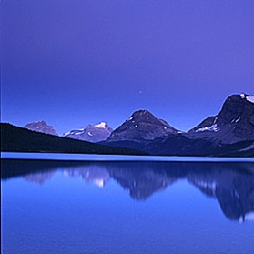
Which class this patch belong to?

Slide 16
SVM
A multi-class SVM algorithm with an RBF kernel is used to classify patches
A grid-search was performed to find the optimal SVM parameters: C and γ
The grid-search was implemented to execute parallelly in MATLAB
On a 4-core 2.5 GHz machine the search ran for 2 days

Slide 17
Grid search results

Slide 18
Patches confusion table for HSV+GLCM+Edges
truth\prediction | field | grass | ground | land | mountain | plain | plants | river | rocks | sand | sea | sky | trees | snow
field | 66.1 | 0.3 | 0.9 | 0.0 | 19.2 | 1.1 | 2.4 | 0.0 | 1.2 | 0.6 | 4.2 | 0.4 | 3.7 | 0.0
grass | 91.9 | 0.0 | 0.0 | 0.0 | 2.0 | 0.0 | 3.0 | 0.0 | 0.0 | 0.0 | 0.0 | 0.0 | 3.0 | 0.0
ground | 19.0 | 0.0 | 4.5 | 0.0 | 46.5 | 0.0 | 0.0 | 0.0 | 0.8 | 1.7 | 14.1 | 13.2 | 0.2 | 0.0
land
mountain | 4.0 | 0.0 | 0.9 | 0.0 | 82.2 | 0.1 | 0.2 | 0.1 | 0.1 | 0.4 | 3.7 | 7.5 | 0.9 | 0.0
plain | 18.5 | 0.0 | 0.0 | 0.0 | 42.9 | 0.0 | 0.0 | 0.0 | 0.0 | 3.6 | 33.3 | 1.8 | 0.0 | 0.0
plants | 49.4 | 0.0 | 0.0 | 0.0 | 28.8 | 0.0 | 7.7 | 0.0 | 0.0 | 0.0 | 0.0 | 0.0 | 14.1 | 0.0
river | 5.0 | 0.0 | 5.8 | 0.0 | 34.7 | 0.0 | 0.2 | 0.5 | 0.0 | 1.6 | 34.3 | 17.9 | 0.0 | 0.0
rocks | 9.0 | 0.0 | 12.5 | 0.0 | 67.4 | 0.0 | 0.0 | 0.0 | 0.0 | 0.0 | 10.4 | 0.0 | 0.7 | 0.0
sand | 4.9 | 0.0 | 0.6 | 0.0 | 27.6 | 0.9 | 0.0 | 0.1 | 0.0 | 12.0 | 32.4 | 21.5 | 0.0 | 0.0
sea | 4.4 | 0.0 | 0.9 | 0.0 | 13.1 | 0.0 | 0.0 | 0.4 | 0.0 | 3.7 | 61.9 | 15.6 | 0.0 | 0.0
sky | 0.0 | 0.0 | 0.0 | 0.0 | 4.4 | 0.0 | 0.0 | 0.0 | 0.0 | 0.5 | 3.6 | 91.4 | 0.0 | 0.1
trees | 30.6 | 0.0 | 0.0 | 0.0 | 49.2 | 0.0 | 0.5 | 0.0 | 0.0 | 0.3 | 1.2 | 1.1 | 17.1 | 0.0
snow | 0.0 | 0.0 | 11.8 | 0.0 | 27.1 | 0.0 | 0.0 | 0.0 | 0.0 | 2.4 | 11.8 | 31.8 | 0.0 | 15.3
General accuracy rate: 71.76%

Slide 19
Patches confusion table for HSV+GLCM+HOG
truth\prediction | field | grass | ground | land | mountain | plain | plants | river | rocks | sand | sea | sky | trees | snow
field | 66.4 | 0.5 | 1.0 | 0.0 | 19.2 | 1.0 | 2.0 | 0.1 | 1.2 | 0.5 | 4.2 | 0.4 | 3.7 | 0.0
grass | 92.9 | 0.0 | 2.0 | 0.0 | 2.0 | 0.0 | 0.0 | 0.0 | 0.0 | 0.0 | 0.0 | 0.0 | 3.0 | 0.0
ground | 19.2 | 0.0 | 4.9 | 0.0 | 46.7 | 0.0 | 0.0 | 0.0 | 0.8 | 1.7 | 13.7 | 12.8 | 0.2 | 0.0
land
mountain | 3.9 | 0.1 | 1.0 | 0.0 | 82.0 | 0.1 | 0.1 | 0.1 | 0.1 | 0.4 | 3.8 | 7.3 | 0.9 | 0.0
plain | 18.5 | 0.0 | 0.6 | 0.0 | 42.9 | 0.0 | 0.0 | 0.0 | 0.0 | 4.8 | 31.5 | 1.8 | 0.0 | 0.0
plants | 53.8 | 0.0 | 0.6 | 0.0 | 27.6 | 0.0 | 3.2 | 0.0 | 0.0 | 0.0 | 0.0 | 0.0 | 14.7 | 0.0
river | 5.5 | 0.0 | 6.1 | 0.0 | 34.3 | 0.0 | 0.0 | 0.6 | 0.0 | 1.3 | 34.4 | 17.8 | 0.0 | 0.0
rocks | 9.0 | 0.0 | 10.4 | 0.0 | 68.1 | 0.0 | 0.0 | 0.0 | 0.0 | 0.0 | 10.4 | 0.0 | 2.1 | 0.0
sand | 5.1 | 0.0 | 0.3 | 0.0 | 28.2 | 0.7 | 0.0 | 0.0 | 0.0 | 13.1 | 32.9 | 19.7 | 0.0 | 0.0
sea | 4.4 | 0.0 | 0.9 | 0.0 | 13.1 | 0.0 | 0.0 | 0.2 | 0.0 | 3.6 | 62.5 | 15.4 | 0.0 | 0.0
sky | 0.0 | 0.0 | 0.0 | 0.0 | 4.5 | 0.0 | 0.0 | 0.0 | 0.0 | 0.4 | 3.5 | 91.4 | 0.0 | 0.1
trees | 30.5 | 0.0 | 0.0 | 0.0 | 50.0 | 0.2 | 0.2 | 0.0 | 0.0 | 0.0 | 1.1 | 0.9 | 17.2 | 0.0
snow | 0.0 | 0.0 | 11.8 | 0.0 | 25.9 | 0.0 | 0.0 | 0.0 | 0.0 | 2.4 | 12.9 | 34.1 | 0.0 | 12.9
General accuracy rate: 71.85 %

Slide 20
Discussion
The accuracy rates are correlated with the sizes of the classes
  Unbalanced dataset
  Learning the prior
Members of smaller classes are often confused with the semantically most similar larger class
Labeling noise
Upper bound on the accuracy rate of local patches

Slide 21
Regions classification
Using the HSI+GLCM+Edges Feature Vector
Every region contains several patches
Associating a region to a category/class gives us a more global knowledge about the scene
Two voting methods
  A single vote per patch
  A weighted vote per patch, according to its probability (an output of the probabilistic SVM)
Will this improve the accuracy rates? Remember that there are usually several patches that form a region.

Slide 22
Regions confusion table for a Single Vote per Patch
truth\prediction | field | grass | ground | land | mountain | plain | plants | river | rocks | sand | sea | sky | trees | snow
field | 71.6 | 0.0 | 0.0 | 0.0 | 21.3 | 1.4 | 0.7 | 0.0 | 0.7 | 0.7 | 2.1 | 0.0 | 1.4 | 0.0
grass | 100.0 | 0.0 | 0.0 | 0.0 | 0.0 | 0.0 | 0.0 | 0.0 | 0.0 | 0.0 | 0.0 | 0.0 | 0.0 | 0.0
ground | 27.6 | 0.0 | 3.4 | 0.0 | 44.8 | 0.0 | 0.0 | 0.0 | 0.0 | 3.4 | 6.9 | 13.8 | 0.0 | 0.0
land
mountain | 5.8 | 0.0 | 0.2 | 0.0 | 85.8 | 0.0 | 0.0 | 0.0 | 0.0 | 0.4 | 2.3 | 4.8 | 0.6 | 0.0
plain | 12.5 | 0.0 | 0.0 | 0.0 | 50.0 | 0.0 | 0.0 | 0.0 | 0.0 | 0.0 | 37.5 | 0.0 | 0.0 | 0.0
plants | 45.0 | 0.0 | 0.0 | 0.0 | 35.0 | 0.0 | 5.0 | 0.0 | 0.0 | 0.0 | 0.0 | 0.0 | 15.0 | 0.0
river | 10.9 | 0.0 | 2.2 | 0.0 | 39.1 | 0.0 | 0.0 | 0.0 | 0.0 | 0.0 | 32.6 | 15.2 | 0.0 | 0.0
rocks | 14.3 | 0.0 | 7.1 | 0.0 | 71.4 | 0.0 | 0.0 | 0.0 | 0.0 | 0.0 | 7.1 | 0.0 | 0.0 | 0.0
sand | 5.5 | 0.0 | 0.0 | 0.0 | 34.5 | 0.0 | 0.0 | 0.0 | 0.0 | 9.1 | 29.1 | 21.8 | 0.0 | 0.0
sea | 5.0 | 0.0 | 0.6 | 0.0 | 13.3 | 0.0 | 0.0 | 0.0 | 0.0 | 1.7 | 64.1 | 15.5 | 0.0 | 0.0
sky | 0.0 | 0.0 | 0.0 | 0.0 | 6.0 | 0.0 | 0.0 | 0.0 | 0.0 | 0.4 | 0.8 | 92.8 | 0.0 | 0.0
trees | 39.6 | 0.0 | 0.0 | 0.0 | 40.7 | 0.0 | 0.0 | 1.1 | 0.0 | 0.0 | 0.0 | 2.2 | 16.5 | 0.0
snow | 0.0 | 0.0 | 0.0 | 0.0 | 40.0 | 0.0 | 0.0 | 0.0 | 0.0 | 0.0 | 0.0 | 40.0 | 0.0 | 20.0
General accuracy rate: 70.77%

Slide 23
Regions confusion table for a Weighted Vote per Patch
truth\prediction | field | grass | ground | land | mountain | plain | plants | river | rocks | sand | sea | sky | trees | snow
field | 70.2 | 0.0 | 0.0 | 0.0 | 22.0 | 1.4 | 0.7 | 0.0 | 0.7 | 0.7 | 2.8 | 0.0 | 1.4 | 0.0
grass | 100.0 | 0.0 | 0.0 | 0.0 | 0.0 | 0.0 | 0.0 | 0.0 | 0.0 | 0.0 | 0.0 | 0.0 | 0.0 | 0.0
ground | 27.6 | 0.0 | 3.4 | 0.0 | 44.8 | 0.0 | 0.0 | 0.0 | 0.0 | 0.0 | 10.3 | 13.8 | 0.0 | 0.0
land
mountain | 4.6 | 0.0 | 0.4 | 0.0 | 86.6 | 0.0 | 0.0 | 0.0 | 0.0 | 0.4 | 2.3 | 4.8 | 0.8 | 0.0
plain | 12.5 | 0.0 | 0.0 | 0.0 | 50.0 | 0.0 | 0.0 | 0.0 | 0.0 | 0.0 | 37.5 | 0.0 | 0.0 | 0.0
plants | 45.0 | 0.0 | 0.0 | 0.0 | 35.0 | 0.0 | 5.0 | 0.0 | 0.0 | 0.0 | 0.0 | 0.0 | 15.0 | 0.0
river | 10.9 | 0.0 | 2.2 | 0.0 | 37.0 | 0.0 | 0.0 | 0.0 | 0.0 | 0.0 | 34.8 | 15.2 | 0.0 | 0.0
rocks | 7.1 | 0.0 | 14.3 | 0.0 | 71.4 | 0.0 | 0.0 | 0.0 | 0.0 | 0.0 | 7.1 | 0.0 | 0.0 | 0.0
sand | 3.6 | 0.0 | 0.0 | 0.0 | 34.5 | 0.0 | 0.0 | 0.0 | 0.0 | 9.1 | 27.3 | 25.5 | 0.0 | 0.0
sea | 5.0 | 0.0 | 0.6 | 0.0 | 12.7 | 0.0 | 0.0 | 0.0 | 0.0 | 1.7 | 63.0 | 17.1 | 0.0 | 0.0
sky | 0.0 | 0.0 | 0.0 | 0.0 | 4.8 | 0.0 | 0.0 | 0.0 | 0.0 | 0.2 | 0.8 | 94.2 | 0.0 | 0.0
trees | 30.8 | 0.0 | 0.0 | 0.0 | 47.3 | 0.0 | 0.0 | 1.1 | 0.0 | 0.0 | 0.0 | 2.2 | 18.7 | 0.0
snow | 0.0 | 0.0 | 0.0 | 0.0 | 20.0 | 0.0 | 0.0 | 0.0 | 0.0 | 0.0 | 0.0 | 60.0 | 0.0 | 20.0
General accuracy rate: 71.34%

Slide 24
Incorporating global context (1)
The project was combined with:
  Non-Local Characterization of Scenery Images: Statistics, 3D Reasoning, and a Generative Model / Tamar Avraham and Michael Lindenbaum
Submitted to CVPR 2011:
  Multiple Region Classification for Scenery Images using Top-Bottom Order and Boundary Shape Cues
The following are now taken into account:
  The relative location of the region
  The height of the region
  The boundary between the regions
  Texture and color

Slide 25
Incorporating global context (2)
only layout
only color&texture
sky
+
sky? sea?
=
sky
mountain
mountain? ground?
mountain
sea? ground?
sea
sea
rocks?plants?
rocks
rocks
Goal: to show that region classification using global + local descriptors is better than only local descriptors
Notes:
So this is nice and we see that our model really captures the gist of scenery images.
However, can the new properties really contribute to the images annotation?
Coming back to the example I showed in the first slide: using only this layout we will be able to say with high certainty that this is sky, this is mountain, but we will not be sure whether this is sea or ground, and whether this is rocks or plants.
On the other hand, if we used only local descriptors, color and texture, then we will not be able to distinguish sky for sea, mountain from ground, but we will be able to say this is sea and not ground, and that these are rocks and not plants.
So the answer is that the layout cues are complimentary for the texture and color cues usually used.
So

Slide 26
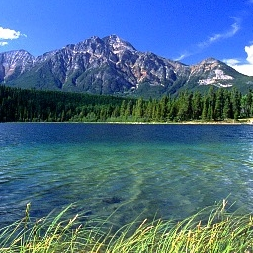

Incorporating global context (3)
top
sky
trees
ground
sea
bottom

Slide 27
Input image
Ground truth
Relative location
Boundary shape
Color & texture
All cues
Notes:
Sometines you see examples where each cue separately fails, but together they succeed. (middle examples)
I specially like the bottom example where the human labeling missed the sea…

Slide 28
Incorporating global context (5)
Accuracy per class:
  Color & texture: higher accuracy for trees, field, rocks, plants, snow
  Layout: better for sky, mountain, sea, sand
  Other classes performance: very low due to their number.
Cue | Accuracy
Color&Texture | 0.615
Relative Location | 0.503
Boundary Shape | 0.452
Relative Loc. + Boundary Shape | 0.573
Color&Texture + Relative Loc. | 0.676
Color&Texture + Boundary Shape | 0.641
All (ORC) | 0.682
19 categories!
Notes:
I’ve of course shown the good examples. Totally, the total accuracy is increased from about 61% using only texture to more than 68% incorporating also the layout cues.

Slide 29
basic classes
high level categories
sky
sea
river
lake
mountain
cliff
plateau
land
field
valley
bank
beach
sand
ground
rocks
plants
trees
grass
snow
SKY
WATER
LAND
land structure
MOUNTAIN
PLAIN
VALLEY
BANK
land cover
SAND
GROUND
ROCKS
PLANTS
TREES
GRASS
SNOW

Slide 30
Input image
ground truth
M-ORC

Slide 31
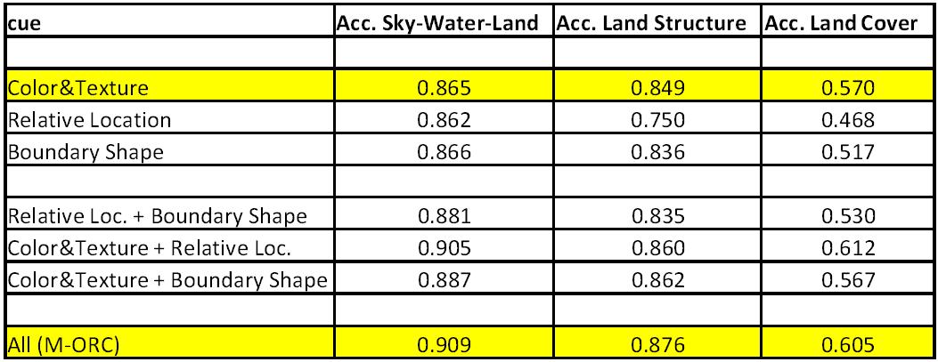
Multiple Ordered Region Classification – Results

Slide 32
Summary
Scenery images
Feature vectors
Optimal parameters
Patches classification
Regions classification
Incorporating global context

Slide 33
Future work…
Segmentation
Scene categorization
Extension to other domains
Picture alignment

Slide 34
Questions?

Slide 35
Thank you!

