Slide 1
Project Presentation
Large Databases for Object Recognition
Project by: Cirill Aizenberg, Dima Altshuler
Supervisor: Erez Berkovich

Slide 2
Introduction
In the recent years everyone knows that Internet contains infinite amount of free data that can be used for large number of applications. Along all the free data out there, we can find billions of images that can be widely used. But there are two major problems that preventing easy access to this reach incredible database, one is that we need a technique to recognize the visual content of the images and the second is the ability for fast search of the huge amount of images.
In our project we implemented one of the new and the promising algorithms that can be found in the computer science community, we will review all the steps of the algorithm, describe the logic behind each step and finally compare the results to other available simple approaches.

Slide 3
Project Goals
Get familiar with existing approaches
Implement the SSL and KNN algorithms
Test the algorithms on toy and real data

Slide 4
Image recognition process
Features extraction
Extracting the most important features from image. Reducing the data size by using Gist descriptor
Dimension reduction
Normalization and reducing the size of the features vector. Using PCA to hold only the top and the most important dimensions
Algorithm Classification
Classifying the unlabeled data using the algorithm in order to receive classification function

Slide 5
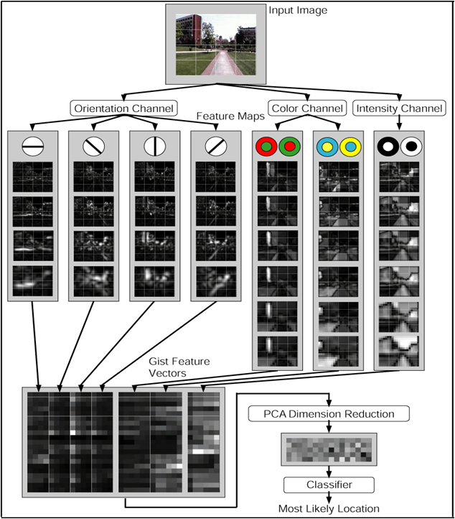
Summary of the process

Slide 6
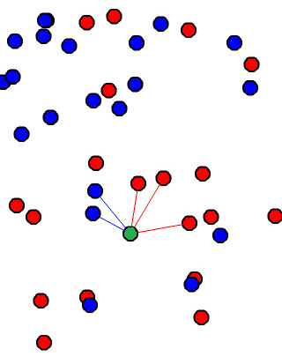
Implementation of the KNN algorithm
K-nearest neighbor (KNN) is very simple algorithm that can classify objects based on closest training examples in the tested dataset. In other words for each unlabeled data point in our space we will test the k nearest labeled neighbors to that point and we will determine the type of the data according to the most common type amongst the k neighbors.

Slide 7
Implementation of the SSL algorithm
The main idea behind the SSL algorithm is that we can use not only the labeled data (supervised algorithms) but also the unlabeled data. We will see that if the algorithm will take in to the consideration the density of the whole data we can receive much better results.

Slide 8
Using Graph laplacian
In order to find classification function we will use graph-based semi-supervised learning. We will define graph Laplacian L that will define a smoothness operator that takes into account the unlabeled data.
The combinatorial graph Laplacian is defined as:
$L=D−W$
$\left.W_{ij}=exp(−∥x_{i}−x_{j}{∥^{2}}/2ε^{2}\right),$ x – data point
$D_{ii}=\sum_{j}{W_{ij}}$

Slide 9
Using Graph laplacian
We want to find f that minimizes:
$$\left.f^{T}Lf+{\left(f−y\right)}^{T}Λ(f−y\right)$$
$f^{T}Lf$– smoothness; $\left.{\left(f−y\right)}^{T}Λ(f−y\right)$ – agreement with labels
y – labels
$Λ$– if point is labeled $Λ_{ii}=λ$otherwise $Λ_{ii}=$ 0
The solution is:
$\left(L−Λ)f=Λy\right. ;n×n$system (n is the number of points)

Slide 10
Alternative way finding Classification function
We do not need to work with the whole graph Laplacian instead we can find smooth vectors that will be linear combination of eigenvectors $U$ with small eigenvalues. We can significantly reduce the dimension of $f$ by requiring it to be of the form $f=Uα$ where $U$ is a $n×k$ matrix whose columns are the $k$ eigenvectors with smallest eigenvalue.
If we choose some values for $k$ like 100 the optimal $α$ will be solution to$k×k$ system $\left(Σ+U^{T}ΛU)α=U^{T}Λy\right.$

Slide 11
Problem finding Classification Function
As we saw in previous section in order to calculate the Classification function we can choose one of two approaches.
Direct resolving – we have to invert L matrix
Use of eigenvectors – we have to find the eigenvectors by diagonalizining L
If we take for example 100 million images we will find out that it's impossible to invert or diagonalize 100 million x 100 million matrix. Because our algorithm developed for large scale databases, 100 million images is a reasonable number for database and this is why there is need to find another solution for finding Classification function.

Slide 12
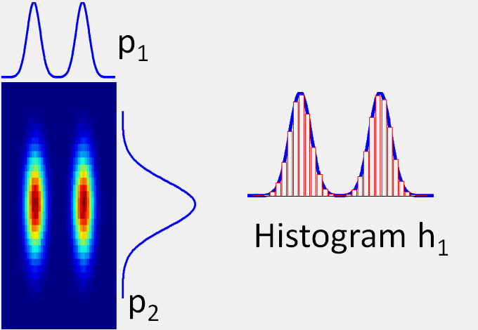
The use of Eigenfunctions
First we will look at the data set as the number of points goes to
n →$∞.$This way we will see the density of the data.
For each marginal distribution we will compute the eigenfunctions. Given a large set of data points we will create a histogram which will be an approximation to the true marginal.

Slide 13
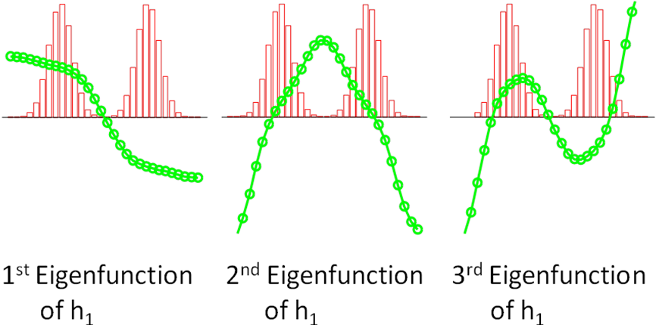
The use of Eigenfunctions
After we calculate all the histograms we can solve for the eigenfunctions of each 1D distribution. We solve for values of the eigenfunction and their associated eigenvalues at the locations of the bin centers. If we will chose bin number as 20 we will get small system 20×20 that is easily solved.
After we have all the eigenfunction for each dimension we can easily find the approximation for the eigenvectors. For each data point we will do a 1D interpolation in the eigenfunction to find the eigenvector value.

Slide 14
Ssl algorithm summary
For each image from input data base create Gist descriptor
For each Gist descriptor vector rotate the data to maximize separabillity (using PCA)
For each of the input dimensions, Construct 1D histogram, Solve numerically for eigenfunction and values
Order eigenfunctions from all dimensions by increasing eigenvalue and take the first k
Interpolate data into k eigenfunctions yields approximate eigenvectors of Laplacian
Solve k x k system to give Classification function

Slide 15
Results

Slide 16
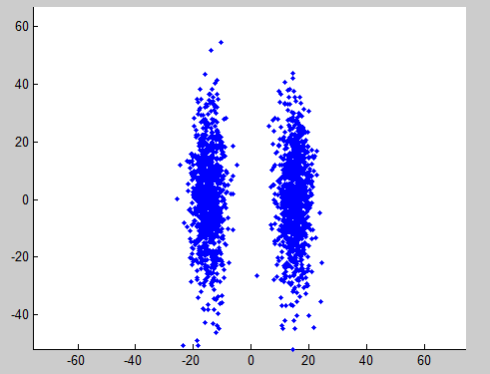
Testing on Toy data
First we tested on simple two dimension data in order to see graphical results.

Slide 17
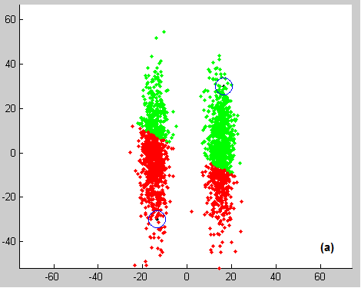
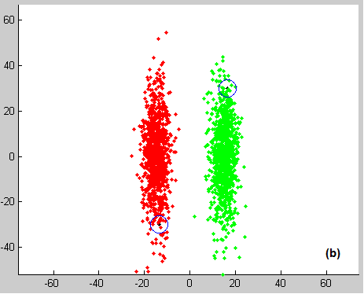
Testing on Toy data
KNN
SSL

Slide 18
Testing on real data
We have chosen online image database called CIFAR-10. This database contains thousands of labeled images but all of them categorized only to ten categories. This database will allow us easy testing because we have limited set of categories and more importantly they all were labeled manually by human. Because the SSL algorithm returns binary classification function each execution we can find images from one of the categories

Slide 19
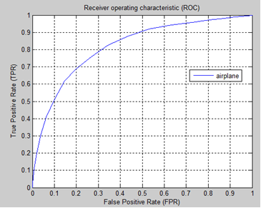
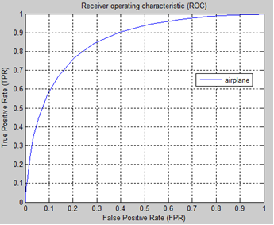
Testing on real data
Correctness of the Classification function
classification results of class “airplane”. Labeled samples contained 50 positives and 100 negatives
classification results of class “airplane”. Labeled samples contained 700 positives and 2500 negatives

Slide 20
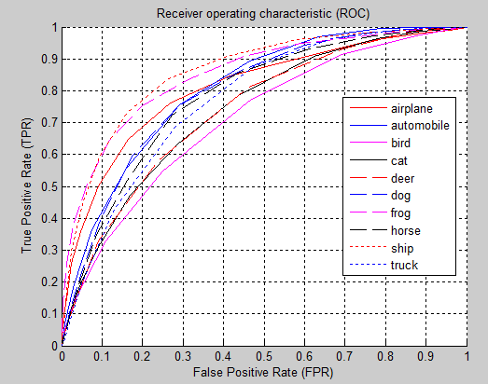
Testing on real data
All classes classification

Slide 21
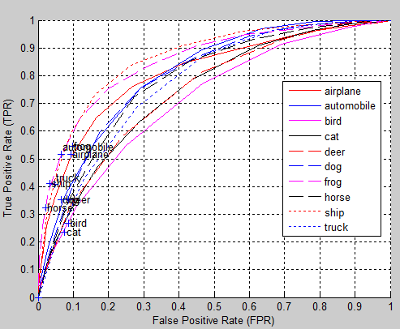
Testing on real data
SSL vs. KNN

Slide 22
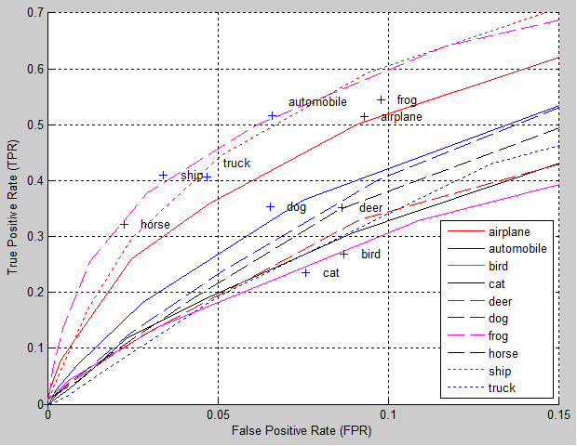
Testing on real data
SSL vs. KNN (zoomed in)

Slide 23
We will now see life presentation
Of the both the algorithms in MATLAB

Slide 24
Conclusions
Classification algorithm that is based on KNN calculation is not complete. It doesn’t take into consideration the density and the smoothness of the data, thus it’s correctness is damaged.
Effectiveness of SSL (based on Eigen-Functions) could be increased, by taking bigger amount of positive and negative samples.
Eigen-Function algorithm can retrieve higher positive true percentage if the systems demand allows higher false positive percentage. It is flexible unlike KNN.

Slide 25
Conclusions (CONTINUE)
Eigen-Functions algorithm has low complexity than other similar algorithms. Which could enhance classification on large databases.
Every class of data is different, thus it requires different tuning for setting the optimum threshold and choosing the most suitable amount of positive and negative samples.
The SSL algorithm (based on Eigen-Functions) has low TPR values, when the allowed FPR is low.

Slide 26
Thank you for your attention!

